Slide 1

Welcome to
Berry Hill Primary School
Thank you for choosing
our Nursery!

Slide 2
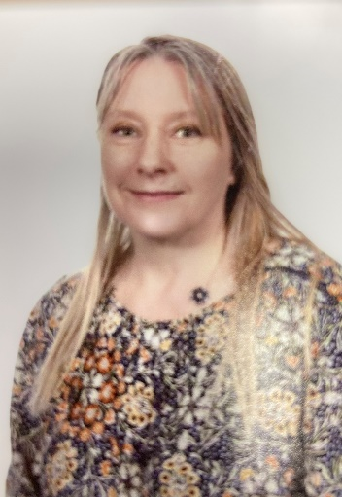
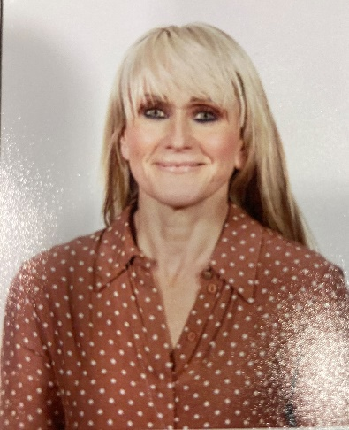
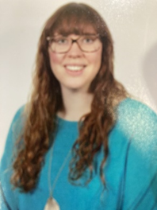
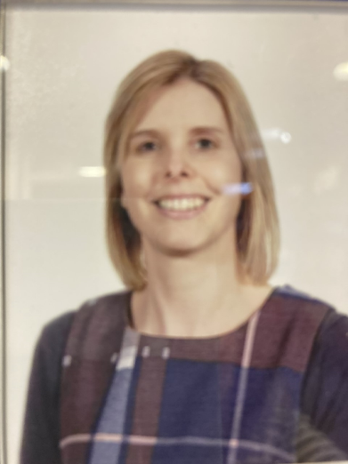
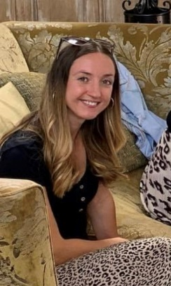
Meet Our Team!
Mrs Kate Miller
Class Teacher
Mrs Helen Comery
Teaching Assistant
Mrs Sarah Woods and Mrs Amy Ireland
EYFS Leads
Mrs Liz Hogg
Teaching assistant

Slide 3
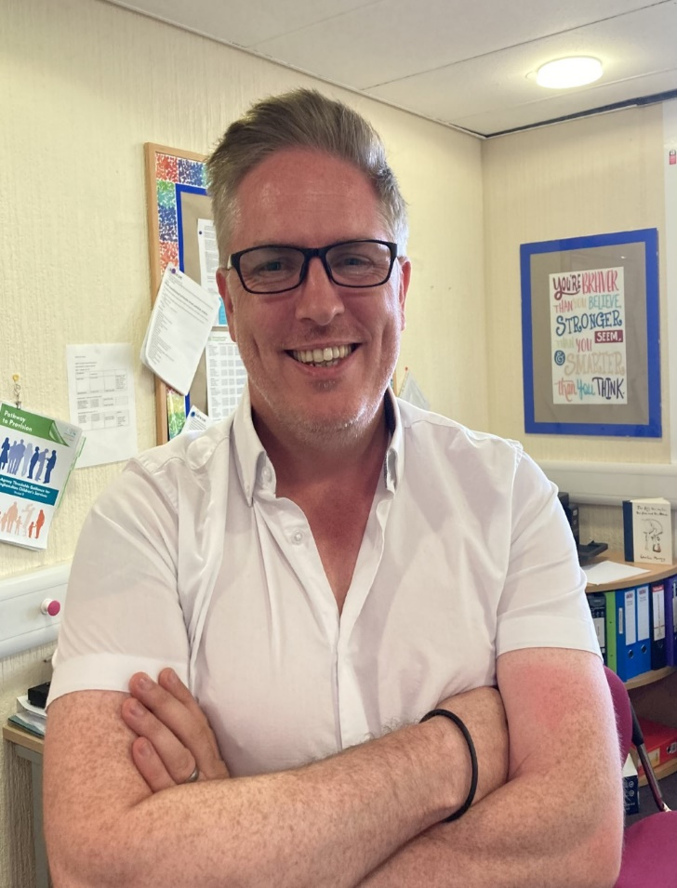
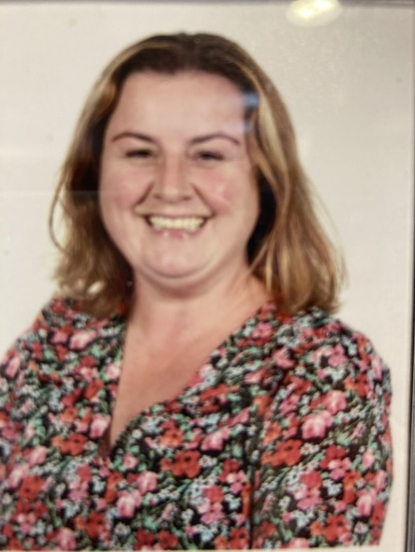
Other people you might meet!
Mr Ben Trenowden
Head Teacher, DSL
Miss Laura Smith
SENCO and DSL
Mrs Sarah Sargoson
Deputy Headteacher, DSL

Slide 4
The EYFS curriculum
EYFS stands for
Early Years Foundation Stage
and comprises Foundation 1 (Nursery)
and Foundation 2 (Reception).
We follow the EYFS Framework (statutory) and
Development Matters (non-statutory).
There are times of whole group teaching, working in small groups and loads of independent learning times.
Young children learn best through
play, interacting and having fun!

Slide 5
Areas of Learning
There are seven areas of Learning and Development:
Prime Areas of Learning
Communication, language and literacy
Personal Social and Emotional development
Physical Development
Specific Areas of Learning
Literacy
Maths
Understanding of the world
Expressive arts and design

Slide 6
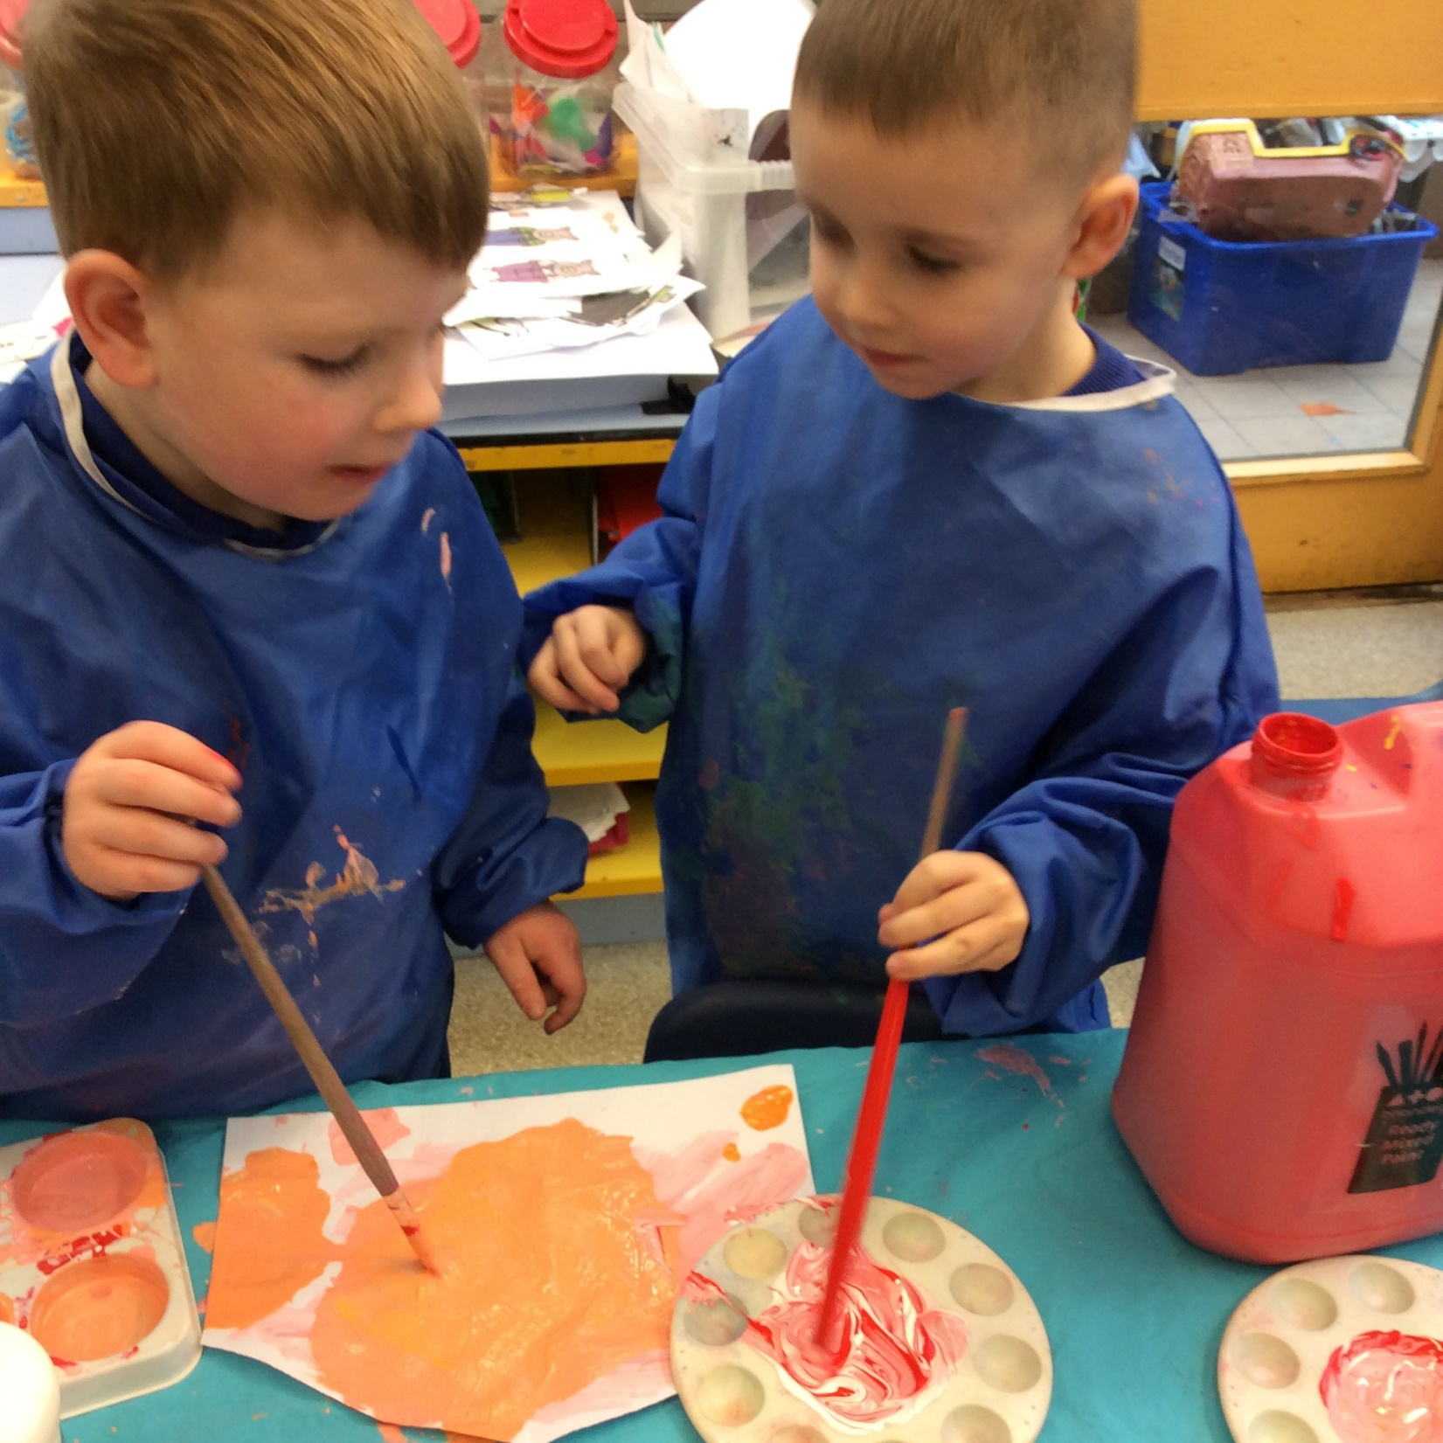
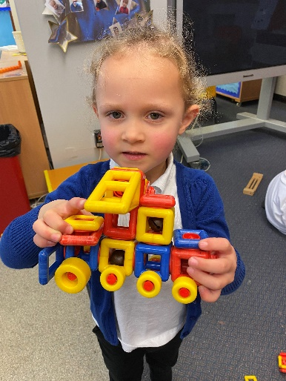
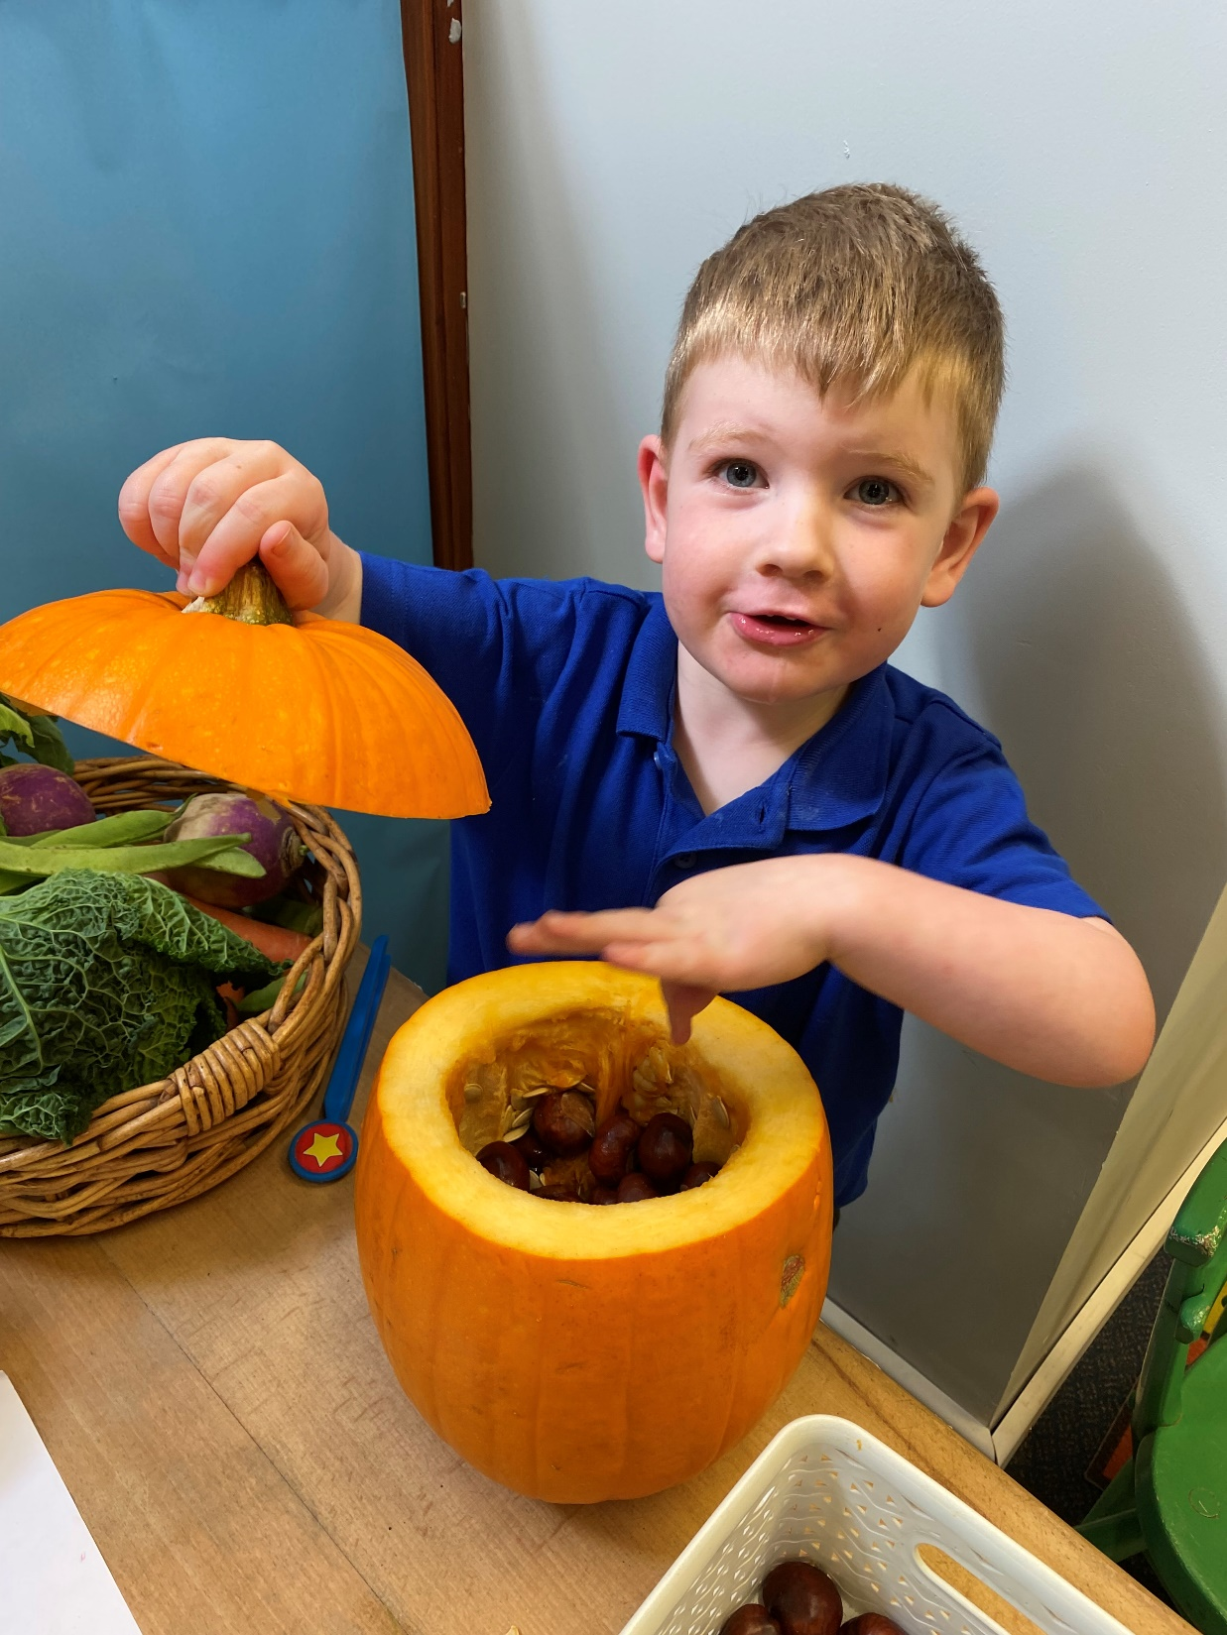
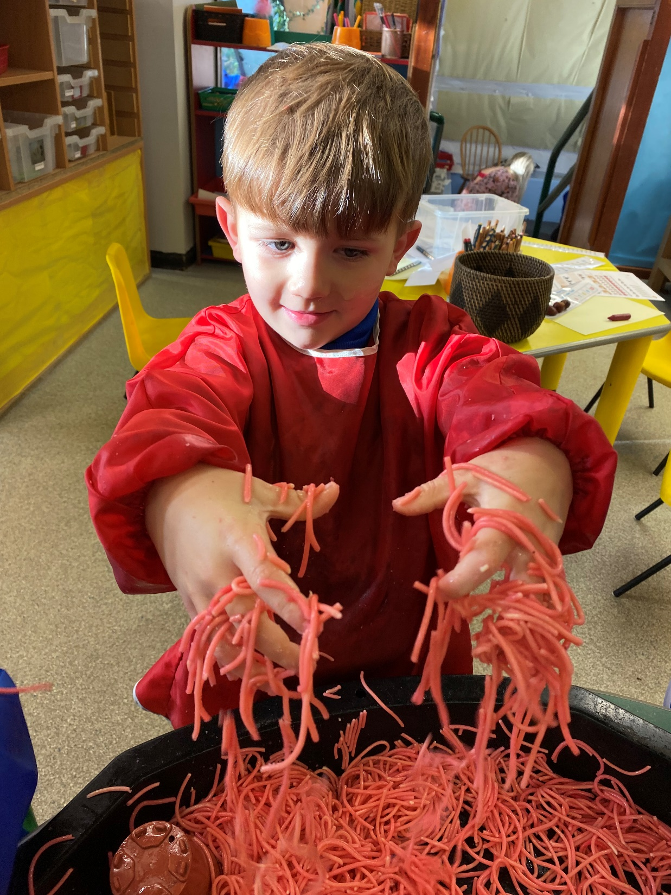
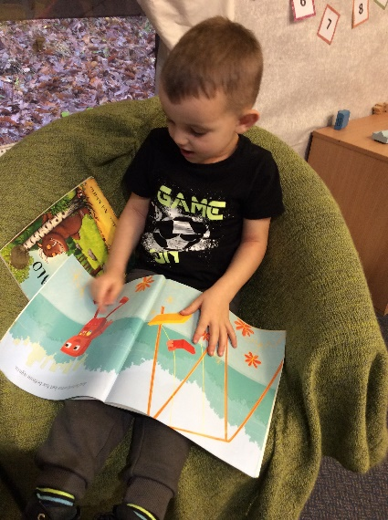
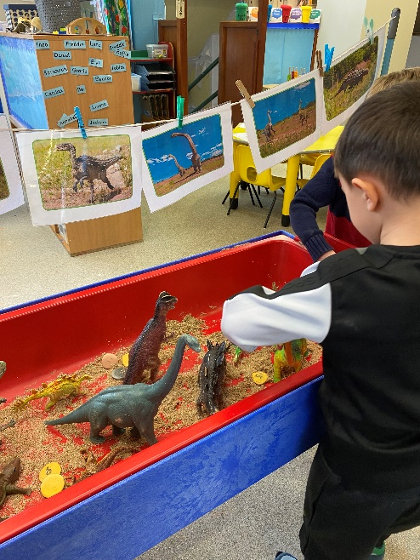
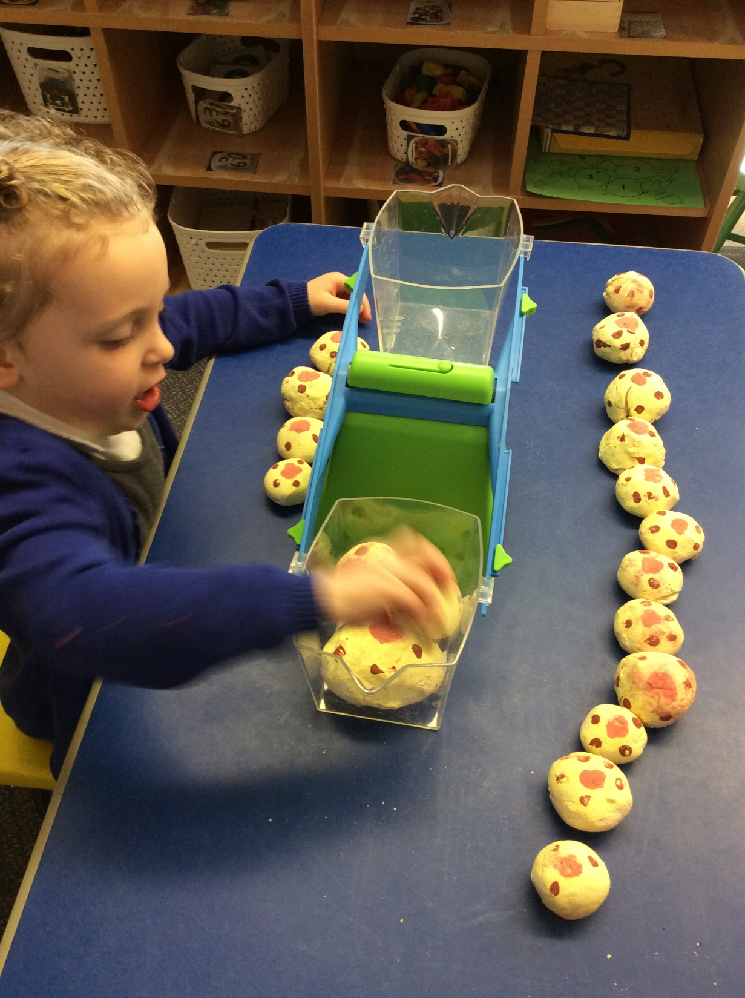
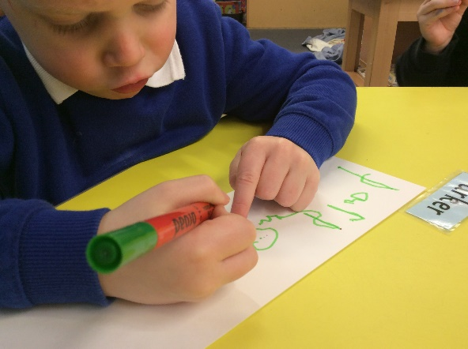
Learning environment
Inside and outside

Slide 7
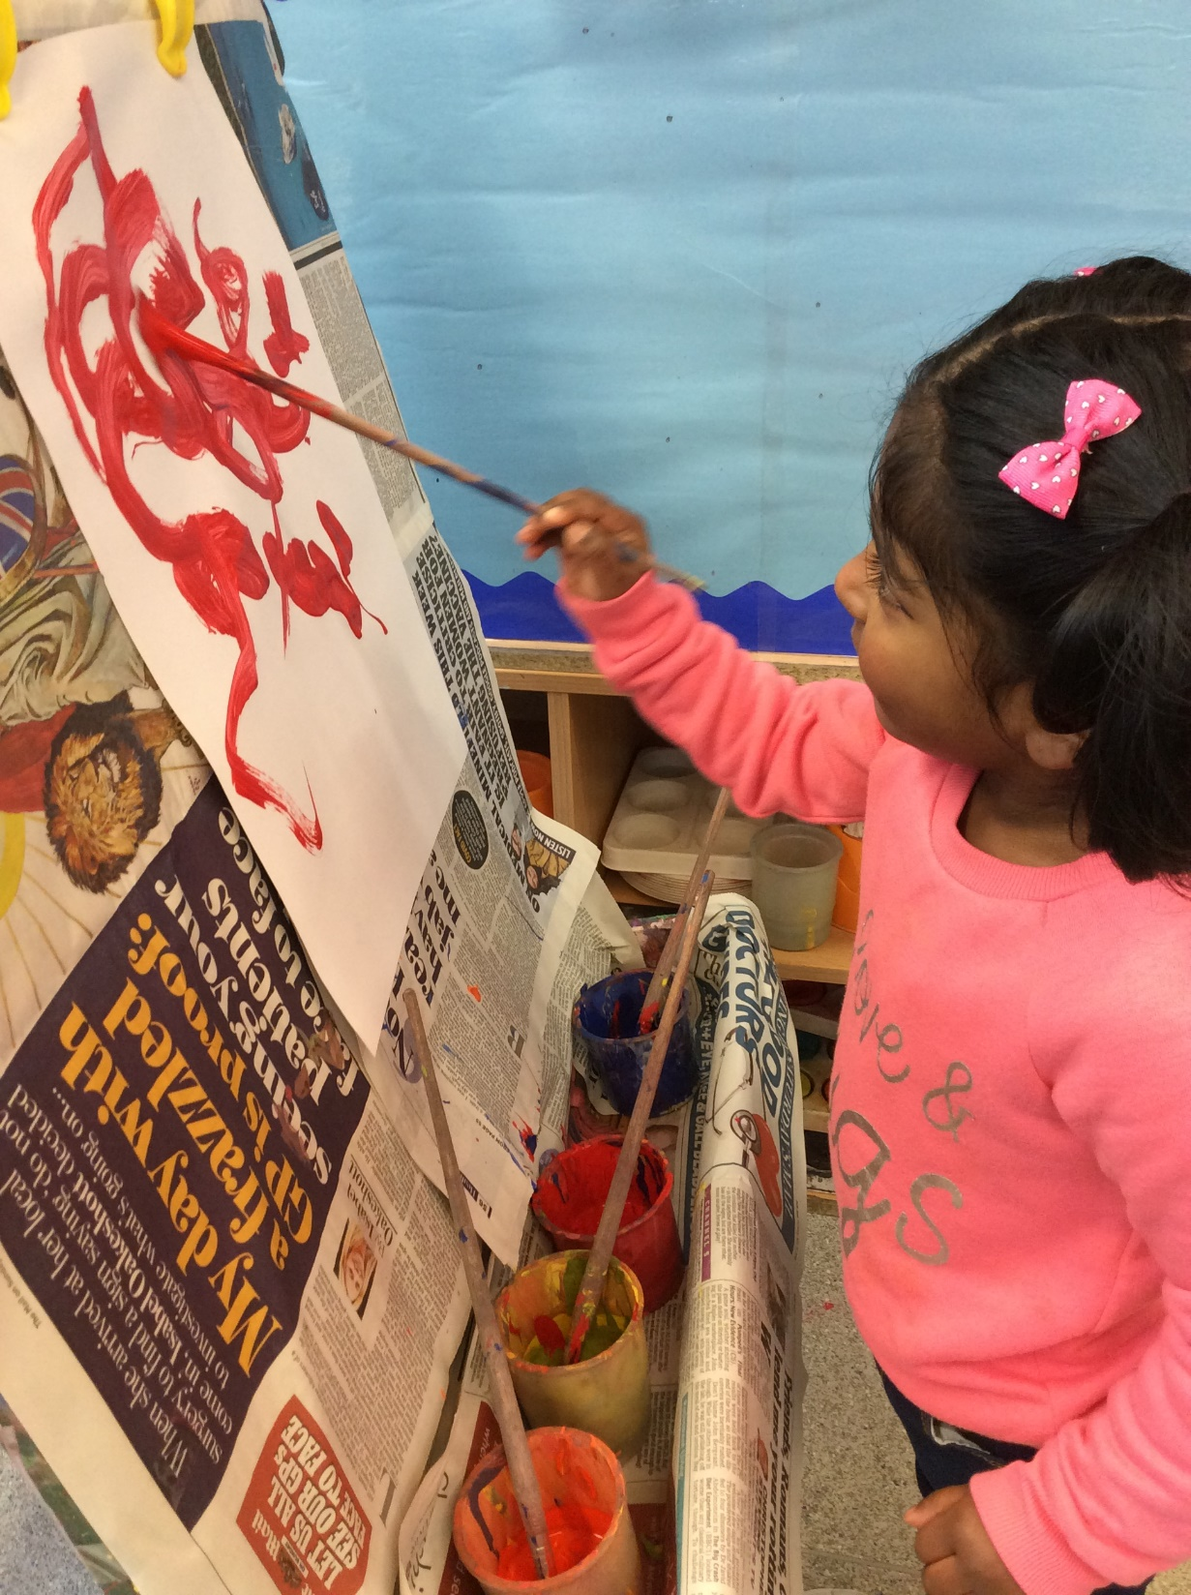
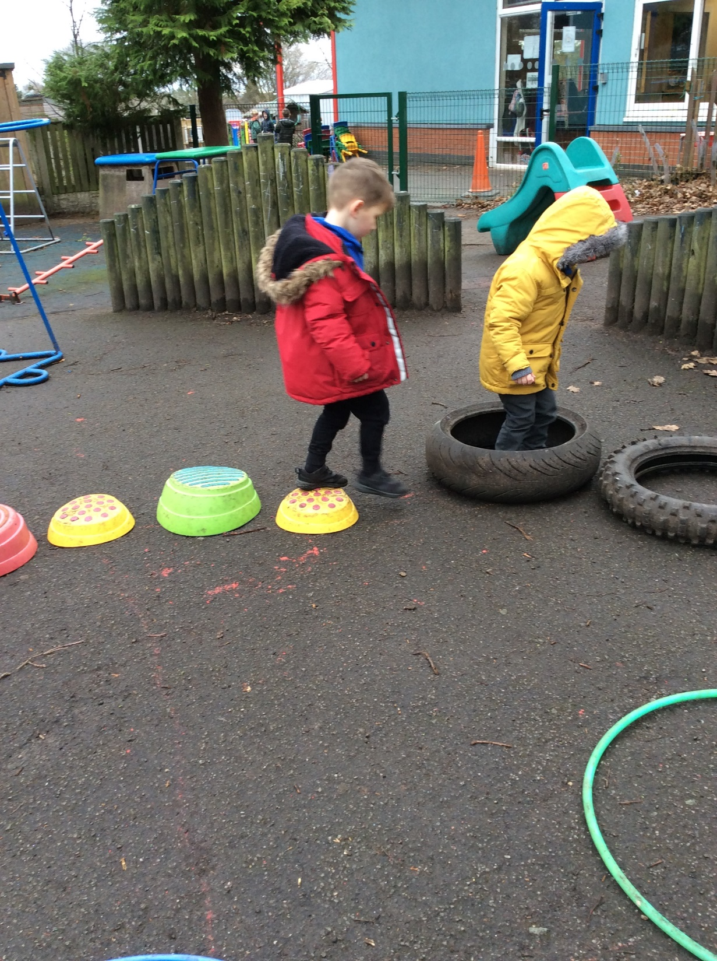
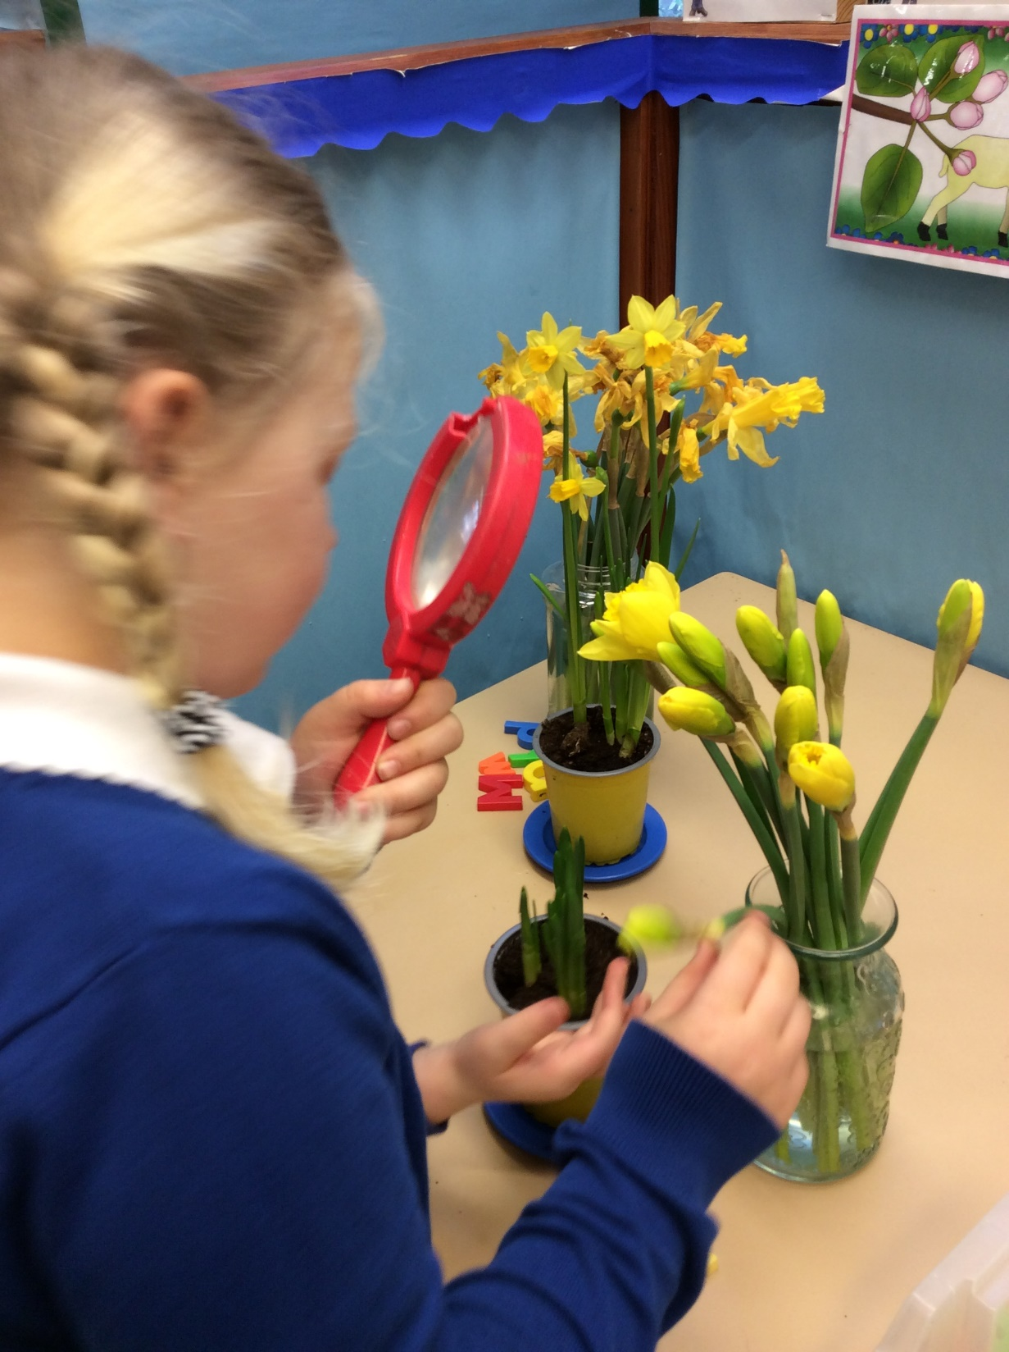
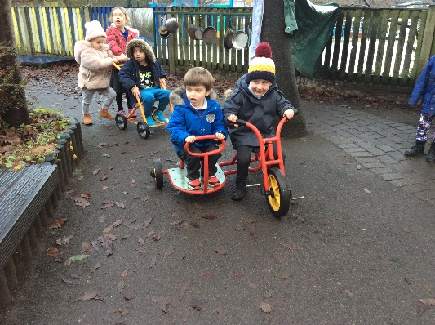
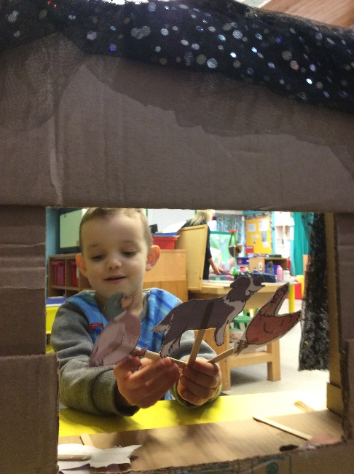
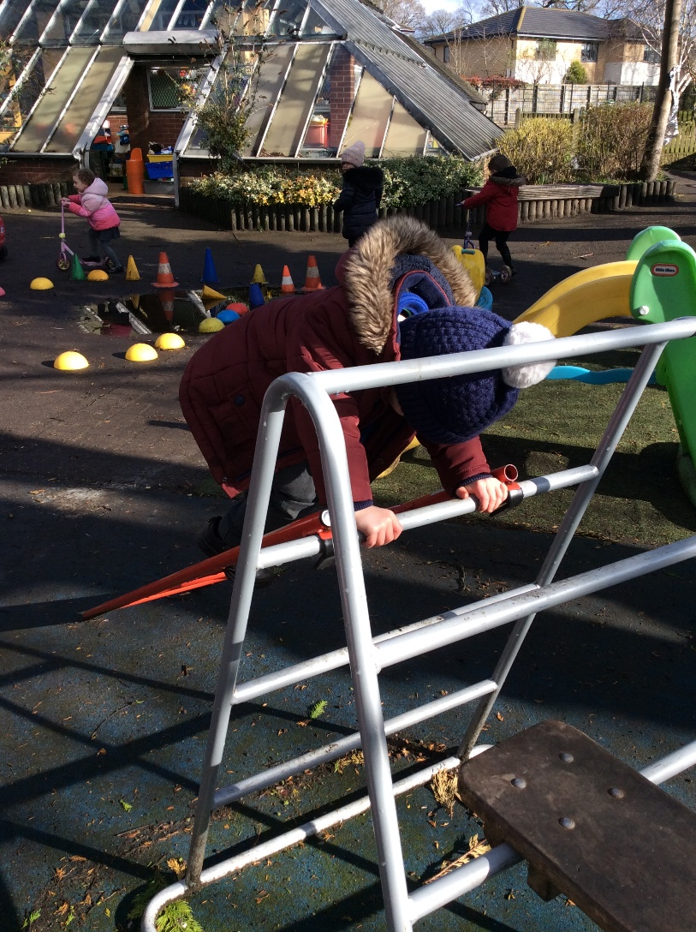
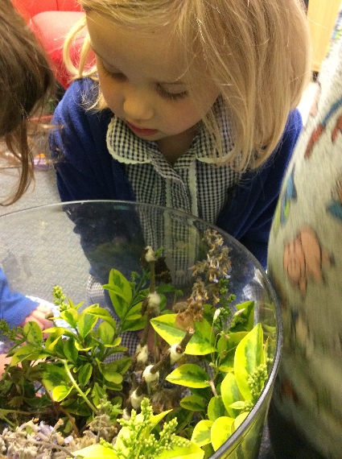
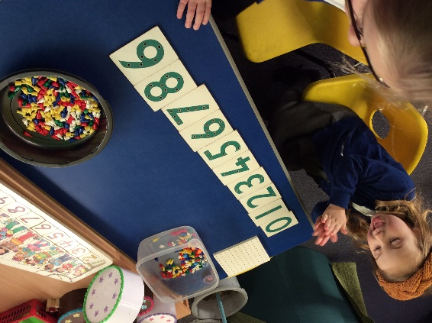
Learning Environment

Slide 8
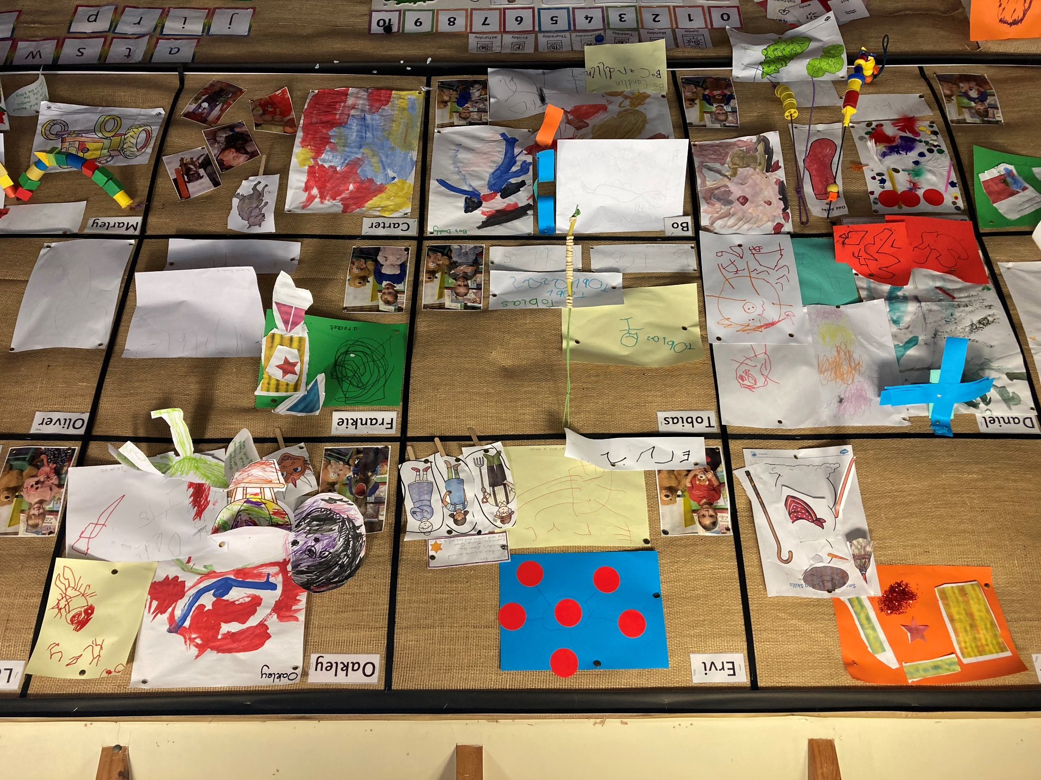

Slide 9

Routine of the day
Morning Nursery:
Nursery starts at 8.45am and finishes at 11.45 pm.
Afternoon Nursery:
Nursery starts at 12.30 and finishes at 3.30 pm.

Slide 10
30 hours (full time)
Full time Nursery:
Nursery starts at 8.45 am and finishes at 3.30 pm

Slide 11
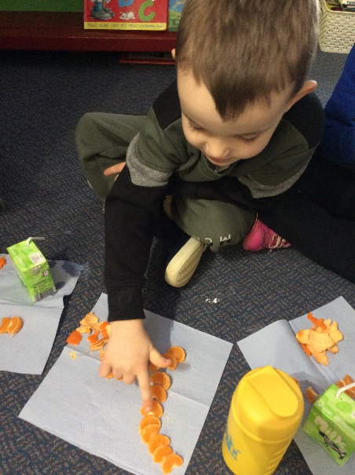
The morning
8.45; Self register and getting busy!
9.30 Small groups session
9.45: busy time
10.45 Tidy up time and snack time
11.05 Carpet time, star of the day, toileting and getting ready for lunch or home time
11.30 Lunch for full time children
11.45: Morning children go home

Slide 12
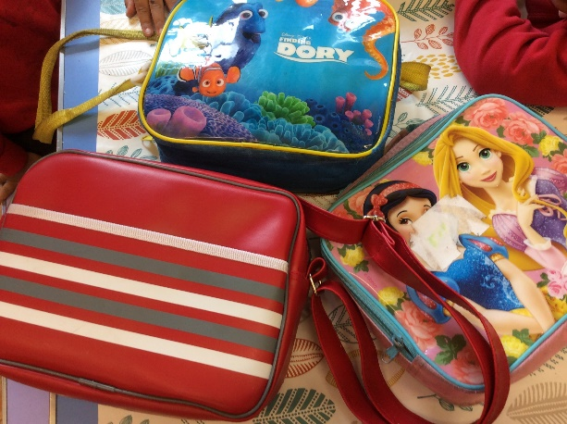
Lunch
Lunch time cover is £3 per day
You will need to bring a packed lunch for your child.
We are a nut free school
So please ensure your
Childs packed lunch
Does not contain nuts

Slide 13
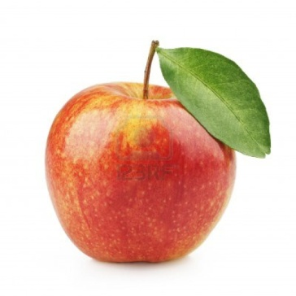
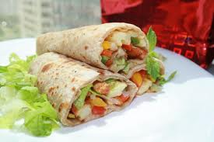
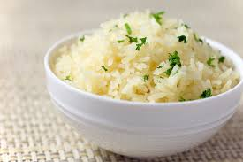
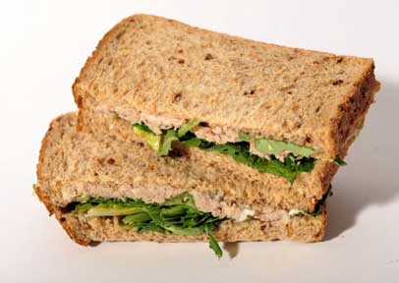



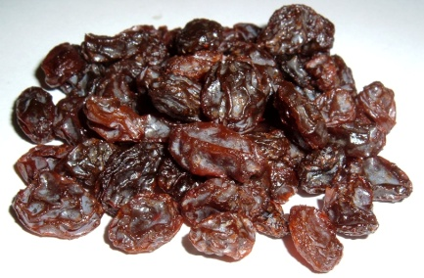
A Healthy Lunch Box

Slide 14
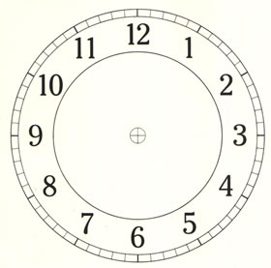
The afternoon
12.30 Register, small group time
12.50: busy time
2.45 Tidy up time
3.00 Story and songs
3.20-3.30 Doors open for Home time

Slide 15
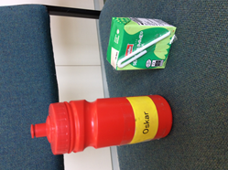
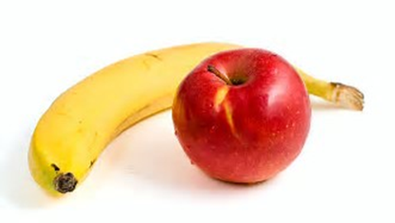
Snack time
We would encourage everychild to bring their own water bottle each day which we will make sure is available
We promote Healthy Eating at Nursery.
The children get a
free milk and a fruit or
You need to register with the cool milk scheme for your child to receive this

Slide 16
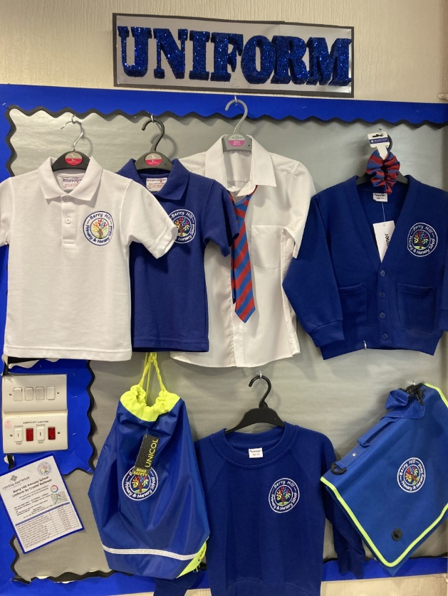
Uniform and Reading Folder
Your children can wear uniform if they would like to
Please label your child’s clothes. Otherwise things might get lost.
Please make sure your child has
appropriate shoes for our outdoor
area
Please only send your child in clothes
That aren’t precious or expensive-
Playing can be messy!

Slide 17
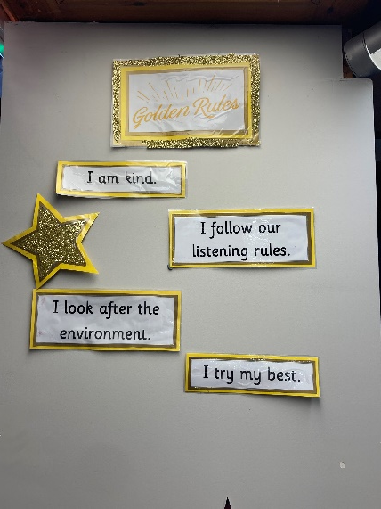
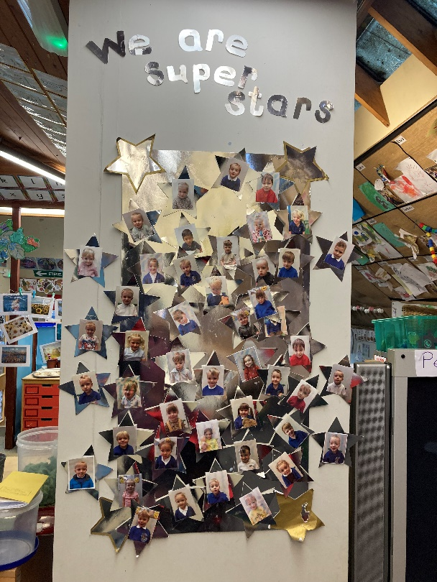
Behaviour management
We have a positive approach to
behaviour. We focus on
self regulation which is part of our
curriculum
Golden Rules!!
I try my best
I look after my environment
I am a good friend
I follow our listening rules

Slide 18

Toileting and self care
Throughout their time in Nursery, children will become more independent in self care skills, such as:
Washing their hands
Putting on and taking off their coats and shoes
Fastening coat zips
Getting changed
Going to the toilet by themselves is another milestone for Nursery children.
Please practise these
skills at home.

Slide 19
Breakfast club and after school club
Breakfast club: Begins at 7.45, £3.50 a day. Contact school office to book a place. This is available for children once they are 4
After School Club: Ran by Sherwood childcare ( outside provider)
Call 07859 666155 to talk about places.

Slide 20
Welcome packs
Welcome to F1
All about me form
Information from the SENCO
Cool Milk leaflet
Uniform ( crystal knitwear) leaflet

Slide 21
Transition and settling in sessions
In your welcome packs, there will be a slip to let you know your childs’ start date.
On that day, they will come and stay with you for a bit and then they can stay for the session.
On the next day that can come for their full session.
All children will be in by Friday 16th September

