Slide 1

Welcome to
Berry Hill Primary
and Nursery School
Thank you for choosing
our school!

Slide 2
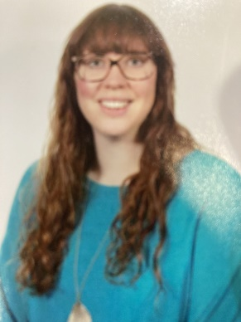
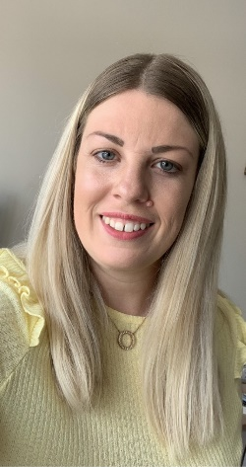
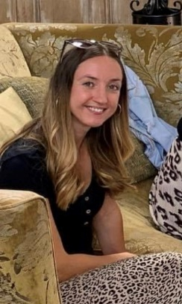
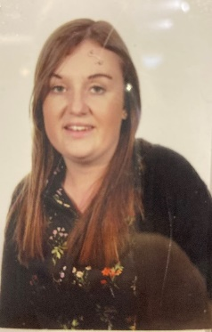
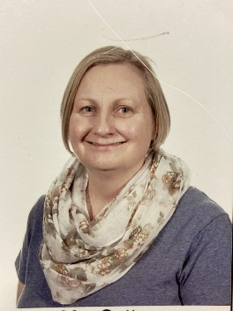
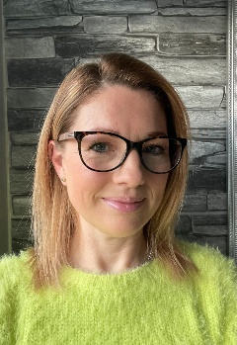
Meet Our Team!
Mrs Sarah Woods
Class 2 Teacher (thurs/ Fri)
Mrs Claire McKinlay
Class 3 class teacher
Class 2
Mrs Amy Ireland
Class 2 Class Teacher
(Mon, Tues, Wed,)
Mrs Tina Kenworthy
Class 3 Teaching Assistant
Mrs Jess Prichard
Class 3 Teaching Assistant
Class 3
Mrs Sally Sutton
Class 2 Teaching Assistant

Slide 3
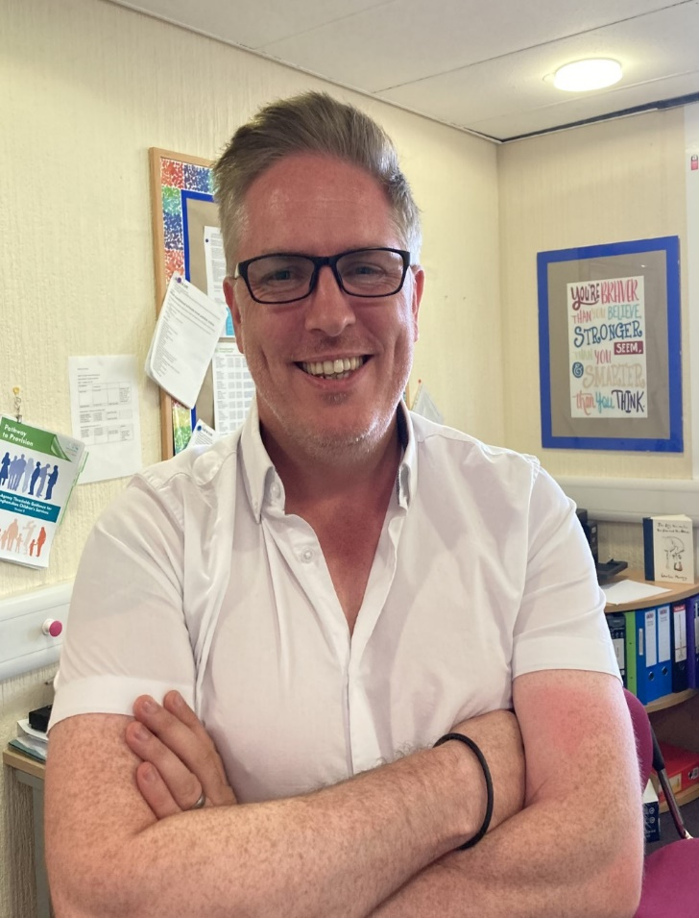
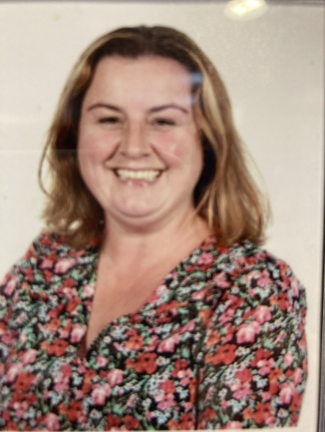
Other people you might meet!
​
Mr Ben Trenowden
Headteacher and DSL
Miss Laura Smith
SENCO and DSL
Mrs Sarah
Deputy Head Teacher

Slide 4
The EYFS curriculum
EYFS stands for
Early Years Foundation Stage
and comprises Foundation 1 (Nursery)
and Foundation 2 (Reception).
We follow the EYFS Framework (statutory) and
Development Matters (non-statutory).
We have focussed teaching times and independent learning times.
During these times, staff might do focused directed tasks or spend time
Interacting with children to take learning on. We aim for no ceiling on learning!
Young children learn best through
play and having fun!
Our aim is to give the children a love of learning! We aim to ‘Equip, Enrich, Embed’ right through Berry Hill Primary school,
and EYFS are childrens first steps in this.

Slide 5
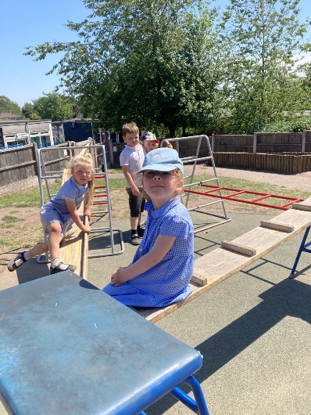
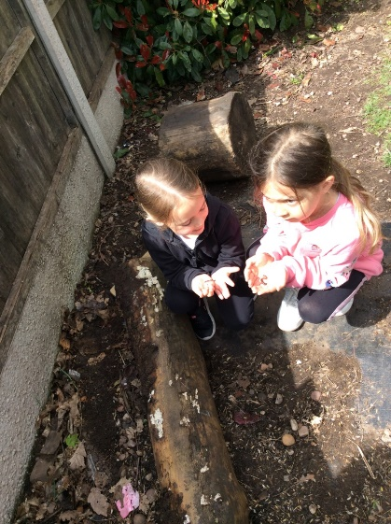
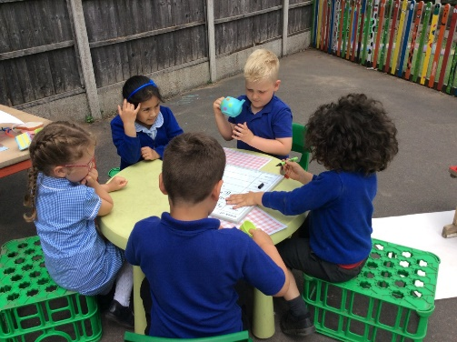
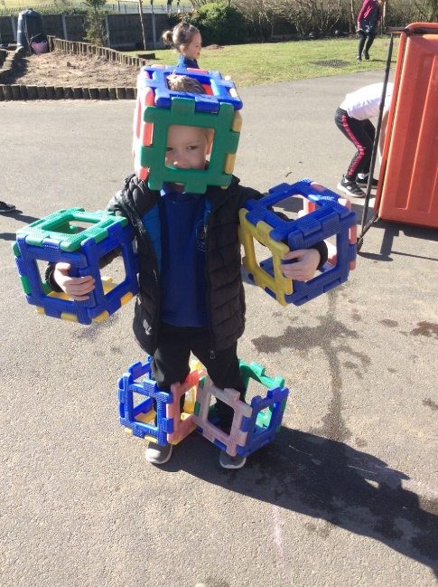
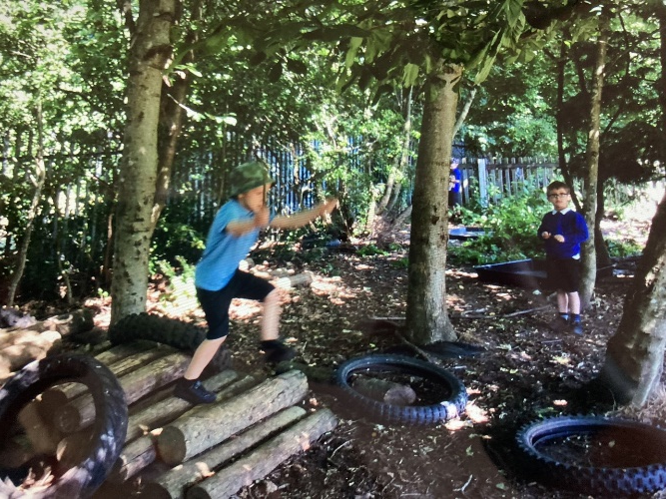
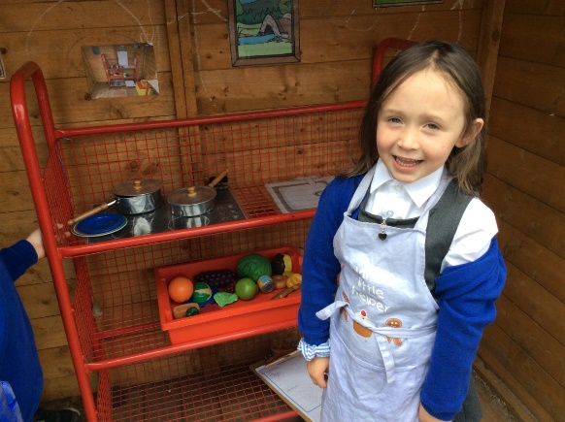
Learning evironment
The two classes work as a unit. Most of the time they can choose freely between being inside and outside.
Outside…
Outside….

Slide 6
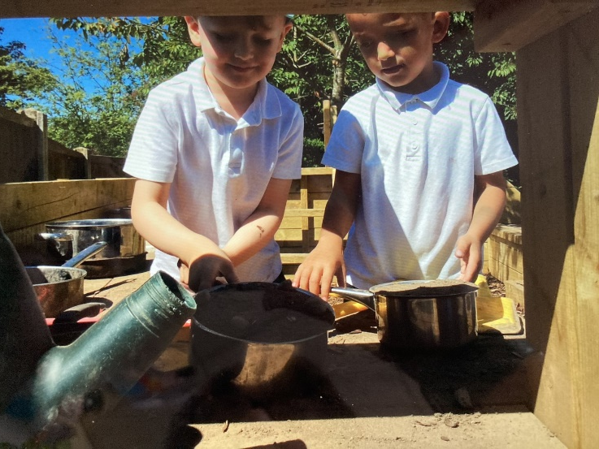
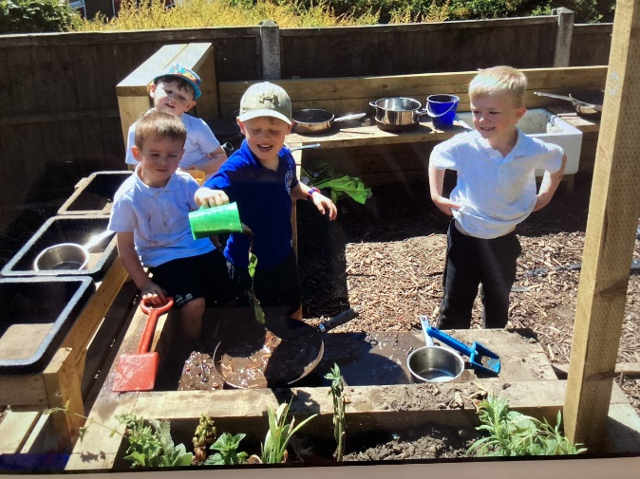
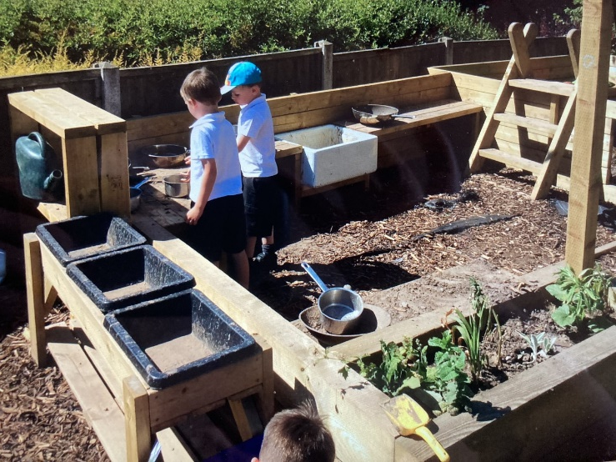
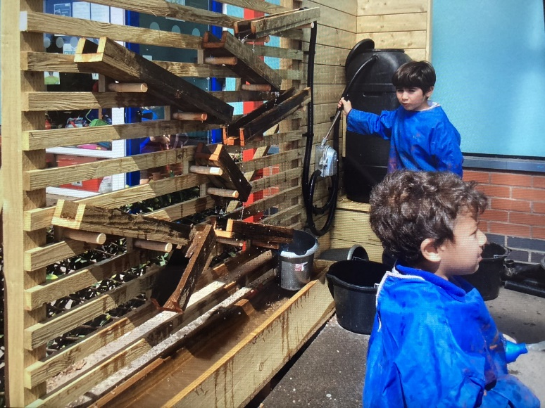
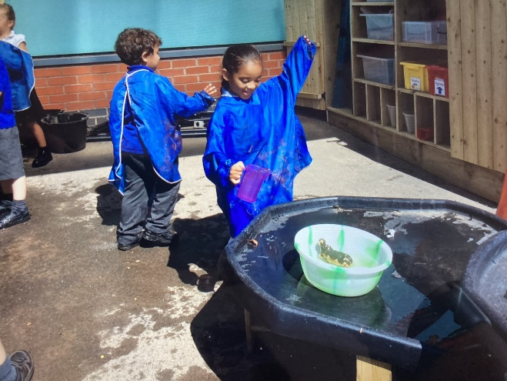
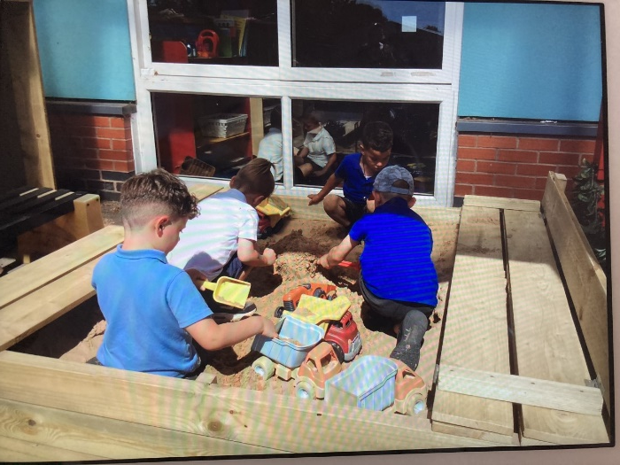
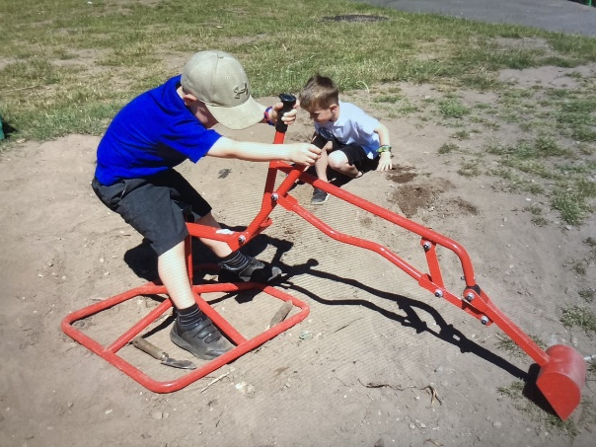

Slide 7
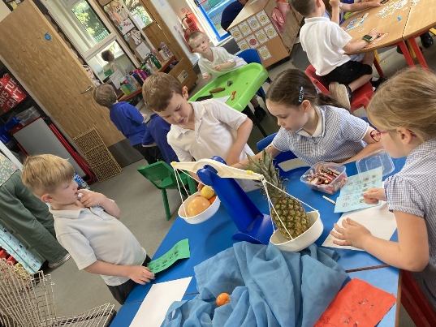
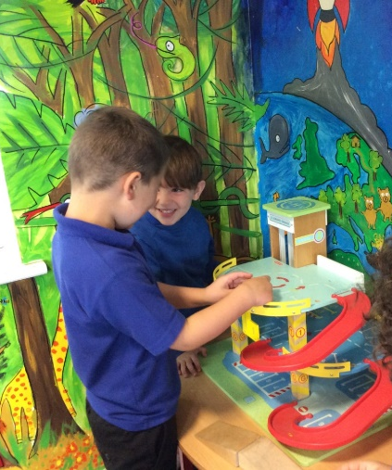
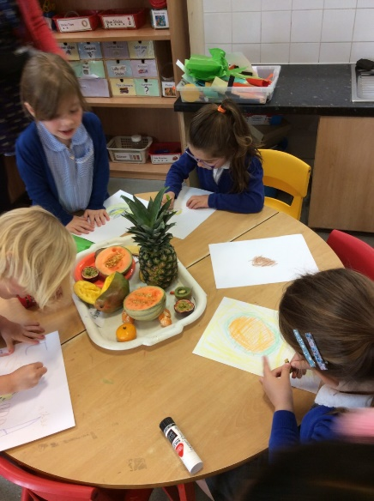
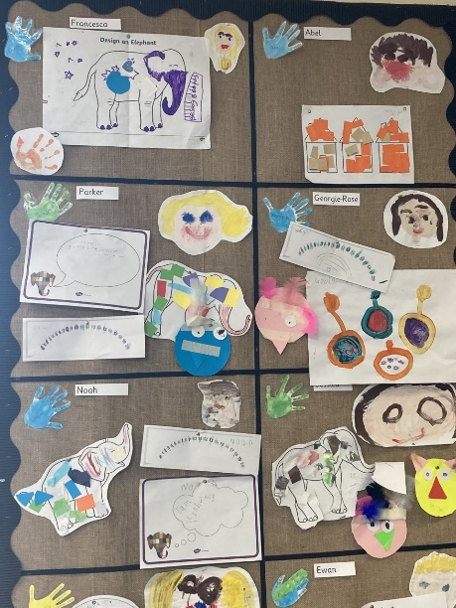
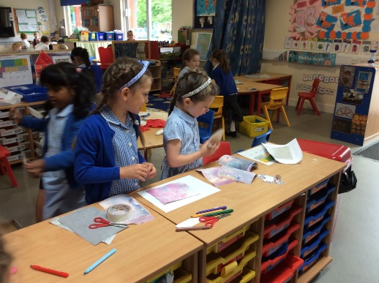
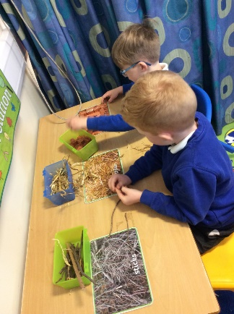
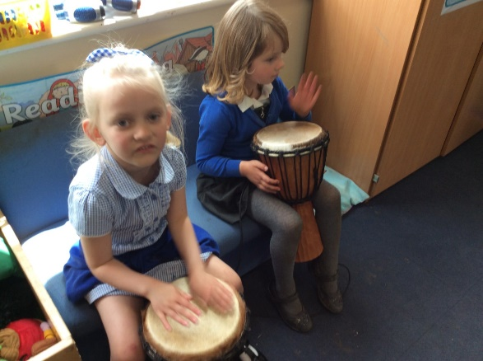
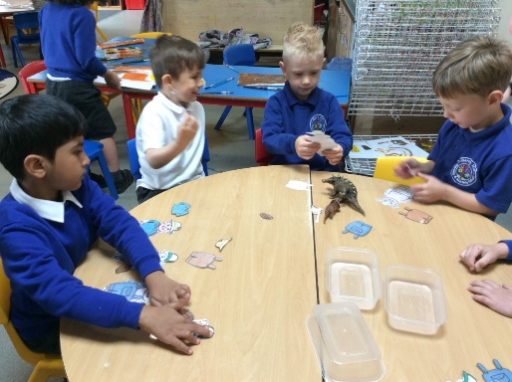
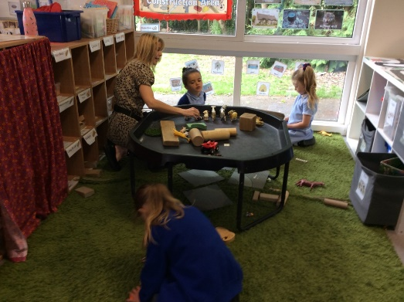
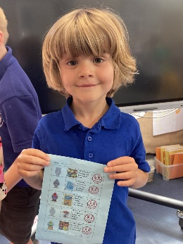
Our learning Environment
Inside…

Slide 8
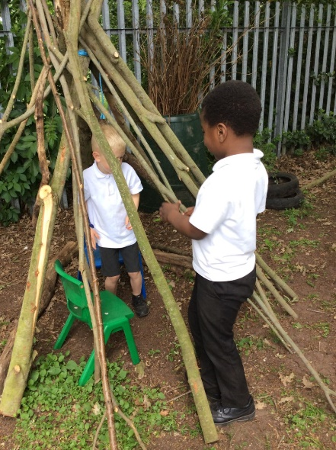
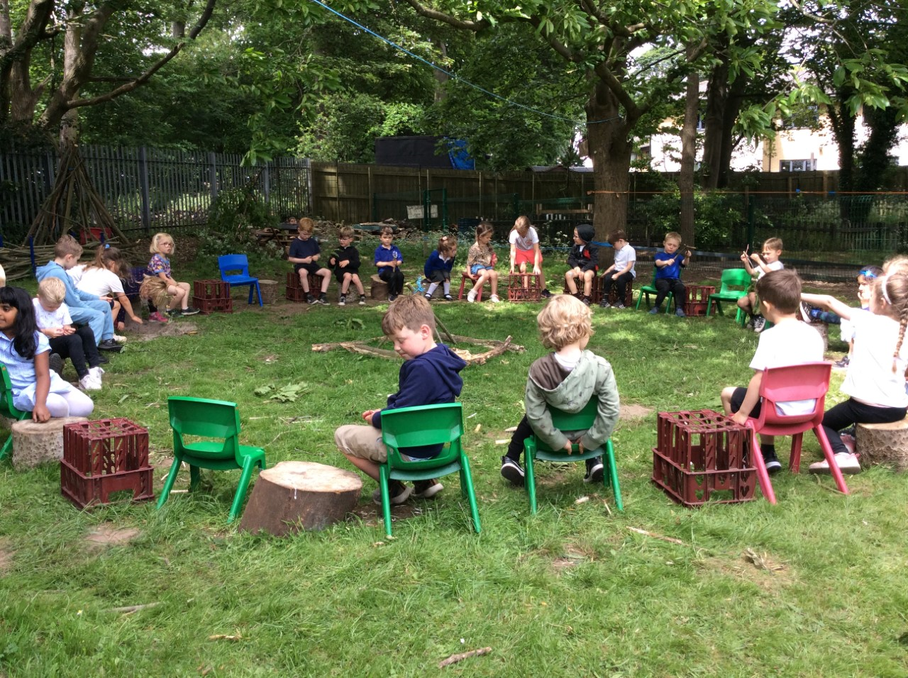
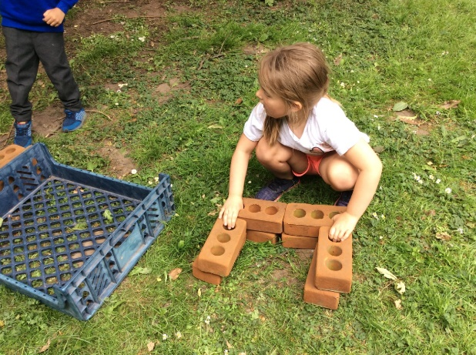
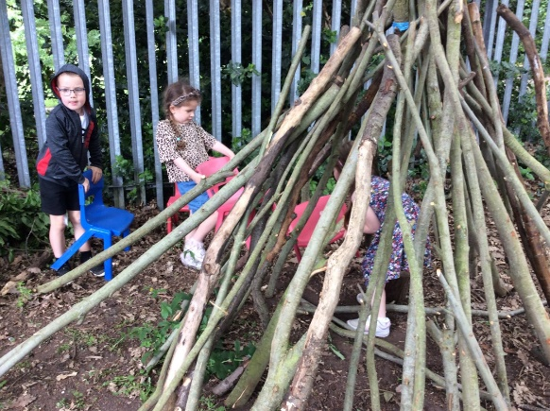
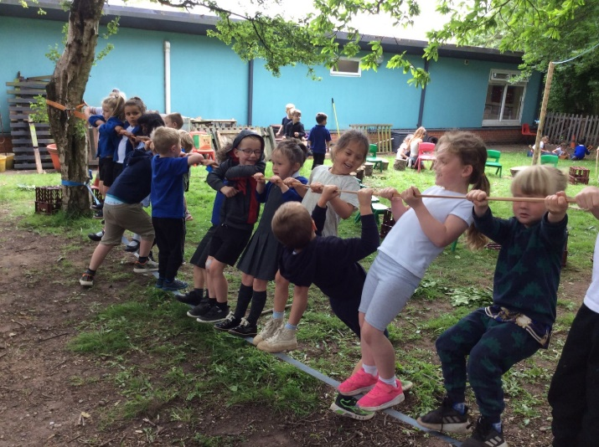
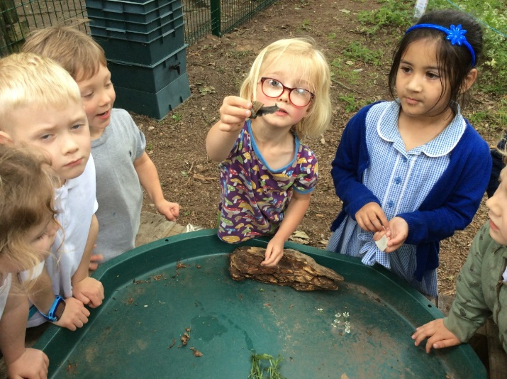
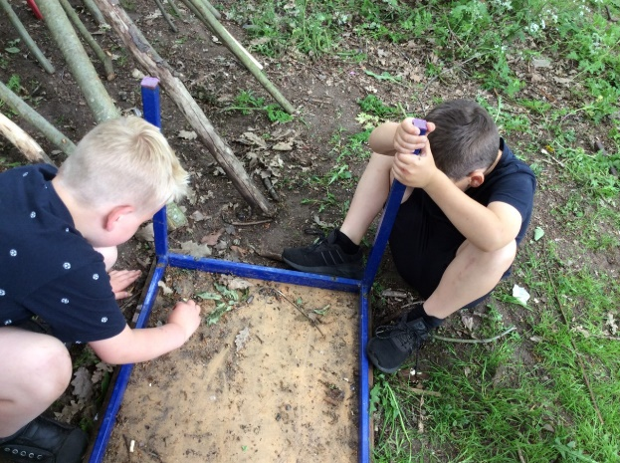
Forest Schools…

Slide 9

Routine of the day
School starts at 8.45 am and finishes between 3.20 pm.

Slide 10
The morning
8.55 Register and morning task
9.05 Phonics session
9.20 Free flow activities
Snack time
11.15 Tidy up time
11.30 Topic/ story carpet session
11.45 Lunch

Slide 11

The afternoon
12.45 Register
1.00 Maths Carpet Session
1.20 Free flow activities
2.30 tidy up time, story time
3.20 Doors open for Home time

Slide 12
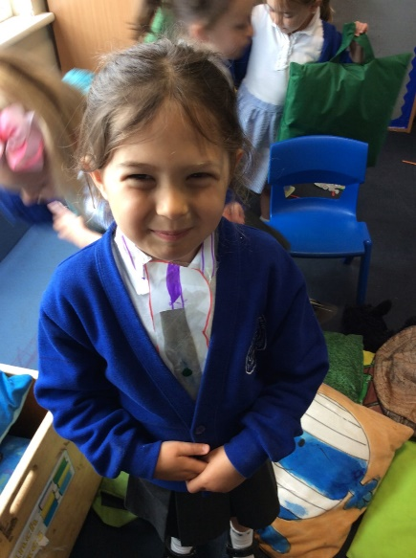
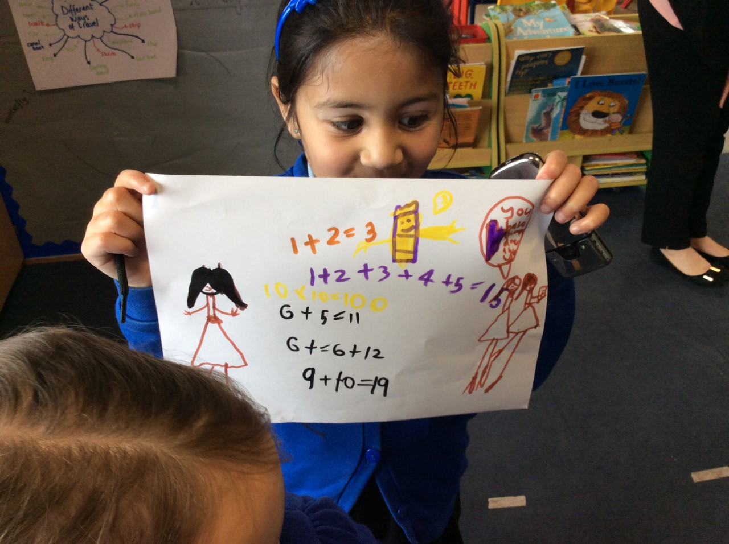
Areas of Learning
There are seven areas of Learning and Development:
Prime areas:
Personal, Social, Emotional Development
Communication and Language
Physical Development
Specific areas:
Literacy
Mathematics
Understanding the World
Expressive Arts and Design

Slide 13
Personal, Social, Emotional Development
What we do at school:
Provide activities that involve turn-taking and sharing in
small groups. Plan small group circle times when children can explore feelings, e.g. help children to recall when they were happy, when they were excited, or when they felt lonely.
What you can do at home:
Prepare your child for starting school. Show them the pictures of their teachers. Talk to them about when they will be starting. Tell them what they will be having for lunch etc.
Play games where they have to take turns ( and don’t always win!)

Slide 14
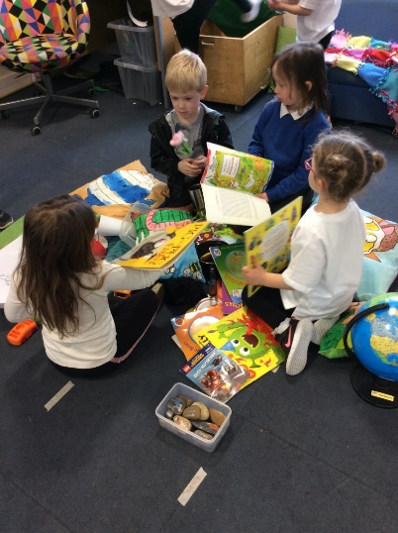
Communication and Language
What we do at school: Provide opportunities for children to participate in meaningful speaking and listening activities.
What you can do at home: Read stories asking children what might happen next or how the story might end.

Slide 15
Physical Development
What we do at school:
We will have a PE session once a week, this will focus on gross motor movements. Throughout the year we will teach the children to use a pencil and hold it effectively to form recognisable letters. We will also discuss how to keep ourselves healthy and safe. Outdoor physical activities will be available everyday.
What you can do at home:
Practice writing your child’s name. This doesn’t always have to be with a pen and paper! Ensure that your child can use the toilet by themselves. When they come to school make sure that they are wearing clothes that they can take on and off easily. Go to the park, run climb and have fun being physically active!

Slide 16
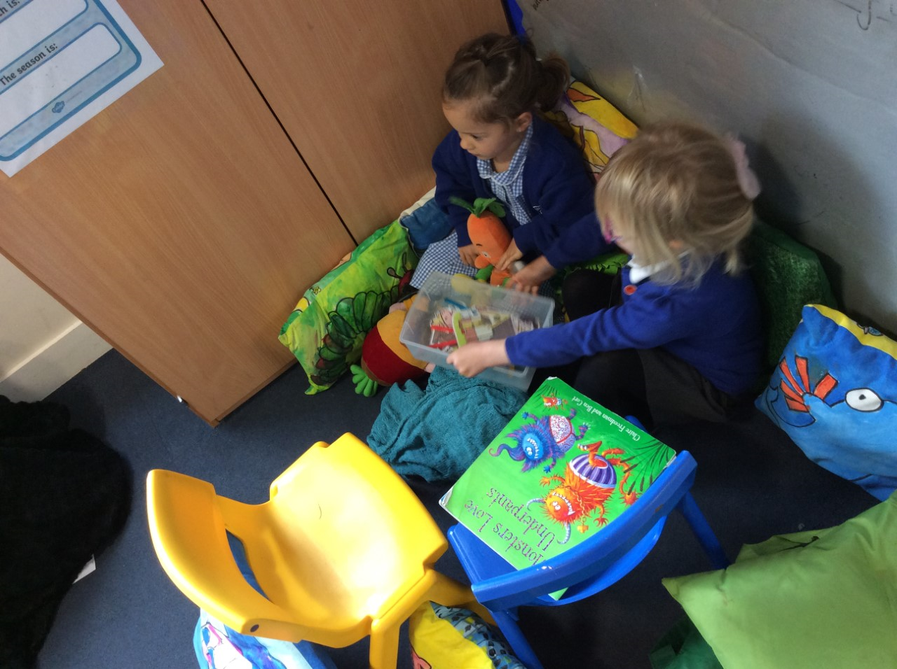
Literacy
(Reading and Writing)
What we do at school:
The children will have daily phonics sessions to help them to read and write. We will listen to them read weekly and they will bring a book home that is at their phonics level. We will read a range of fiction and non fiction texts with the children...we aim for '5 texts a day'. We aim to instill a love of reading and writing!
What you can do at home:
Model oral blending of sounds to make words in everyday contexts, e.g. ‘Can you get your h-a-t hat?’
Talk to children about the letters that represent the sounds they hear at the beginning of their own names and other familiar words.
Read a bedtime story every night. Read their levelled book with them when you can. We encourage 5 times a week.
Get them to help writing shopping lists or birthday cards

Slide 17
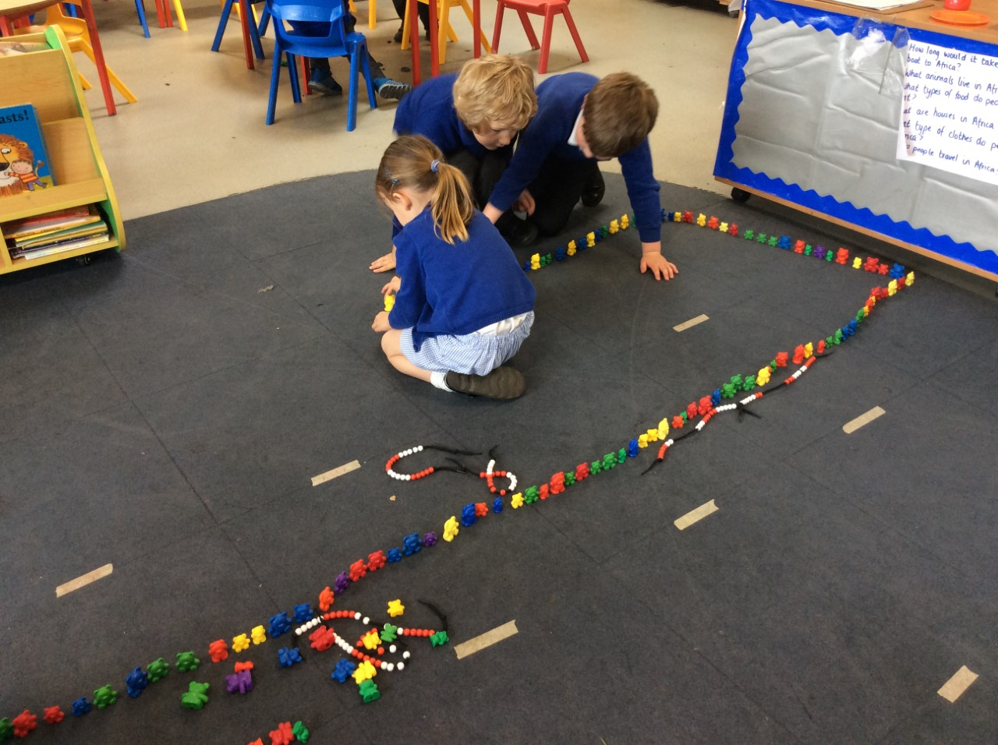
Mathematics
What we do at school: Have a maths session daily which focuses on Numbers predominantly but also Shape, Space and Measure. We focus on 1 number for 2 whole weeks, ensuring all children have a good grip of what they are.
What you can do at home:
Ask your child to set the table for a particular number of people. Can they get the right number of knives and forks?
Talk about the shape of everyday objects for example tall and round.
Play games with them- snakes and ladders/ track games etc

Slide 18
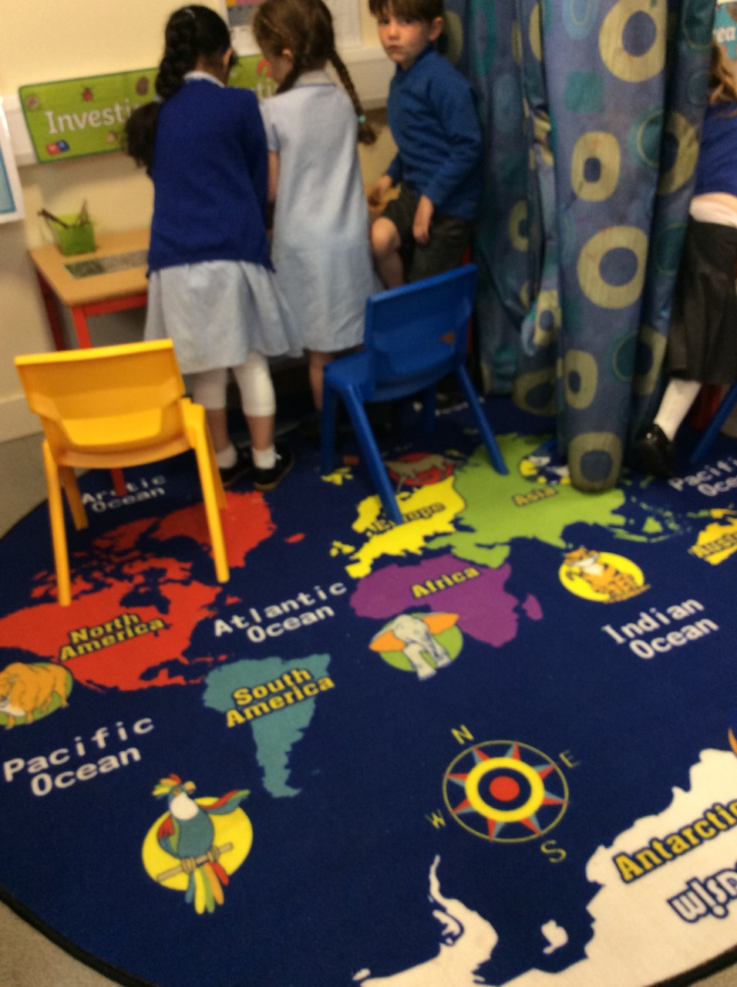

Understanding the World
What we do at school: Celebrate different cultures and value the culture of everybody in the class. Give children the opportunity to observe the natural world.
What you can do at home: Do some cooking together and talk about how the ingredients have changed. Go to a park or natural place, can you see beautiful leaves, flowers or mini-beasts? Talk to older relatives or friends about how life has changed. Follow a simple map to get to school or the park or to find some treasure!

Slide 19

Expressive Arts and Design
What we do at school: Provide resources so that the children can play imaginatively, for example a role-play area and den building materials. Help the children to build up a repertoire of songs and dances. Give the children materials that they can make their own models with.
What you can do at home: Sing some favourite songs and rhymes. Play with small world toys together and make up a story.

Slide 20
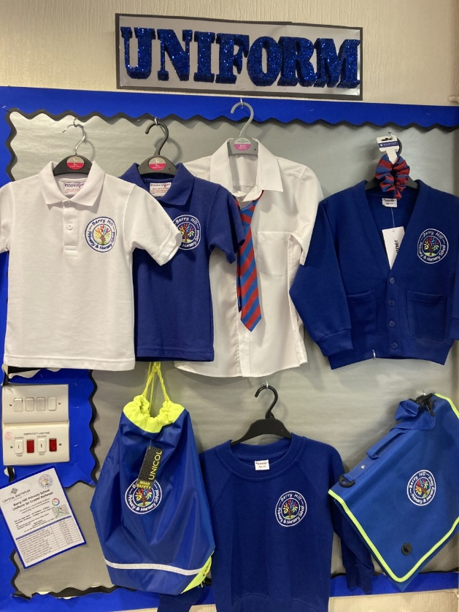
Uniform and Reading Folder
School uniforms should be worn every day and book bags brought to school daily.
Please label your child’s clothes. Otherwise things might get lost.
We will let you know about PE days and Forest Friday.

Slide 21
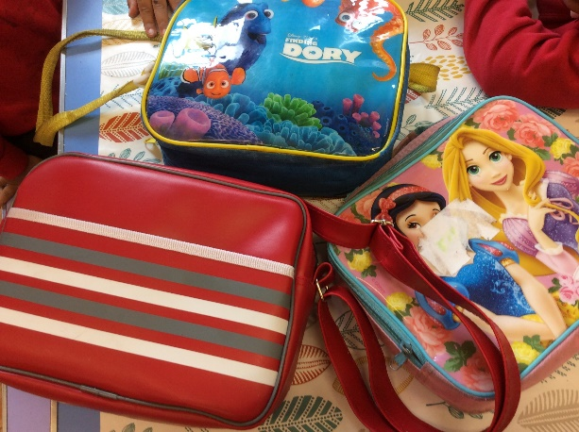
Lunch
You can choose from:
School dinners
School sandwich
Packed Lunch
School dinners are free for F2 children.

Slide 22

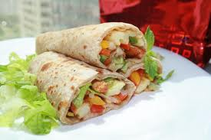
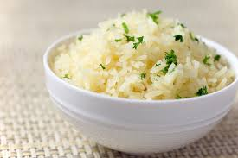
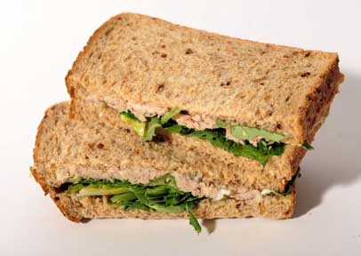



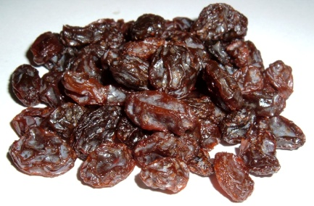
A Healthy Lunch Box

Slide 23


Snack time
We would encourage every child to bring their own water bottle each day which we will make sure is available
We promote Healthy Eating at Berry Hill Primary School.
The children get a ​free milk and a fruit or vegetable. Once they turn 5, they will need to pay for milk if they would still like it. ​

Slide 24


Behaviour management
We have a positive approach to
behaviour. We focus on
self regulation which is part of our
curriculum
Golden Rules!!
I try my best
I look after my environment
I am a good friend
I follow our listening rules
Whole class
rewards
Sticker charts

Slide 25
Toileting and Self Care
We need your support!
Its great if your child can go to the toilet by themselves, including being able to undo and do up their own trousers and wiping themselves.
Please practise these skills at home.
Let us know if your child needs support and how we can help :-)
Please bring a bag of spare clothes for your child.

Slide 26
Breakfast club and after school club
Breakfast club: Begins at 7.45, £3.50 a day. Contact school office to book a place
After School Club: Ran by Sherwood childcare ( outside provider)
Call 07859 666155 to talk about places.

Slide 27
Welcome packs
Introduction to EYFS at Berry Hill
All about me form
Admissions form
50 things to do before you are 5!
Are you ready for School…
Golden rules!
Information from the SENCO
Cool Milk leaflet
Uniform ( crystal knitwear) leaflet

Slide 28
Transition sessions…
We will have our transition sessions for children on Tuesday 5th July .
Class 2 will come in the morning (9.30-11.30)
Class 3 will come in the afternoon ( 12.30-2.30)
The first day back for our F2 children will be: Monday 5th September.
Monday 5th: All children will come on Monday 5th for a morning session ( 8.45-11.45)
Tuesday 6th: All children will come for a morning session and lunch ( 8.45-12.45)
Wednesday 7th September: All children in Full Time

