Slide 1
Phonics in EYFS at Berry Hill Primary School
A guide for parents…

Slide 2
What is phonics?
It’s a systematic approach to teaching reading and writing effectively- 80% of children learn to read and write best this way.
We teach phonics daily for 15-20 minutes
There are 6 phases within phonics and they generally are taught in this way:
Phase 1( building blocks) - Taught in Nursery ( environment sounds/ rhythm/rhyme/ aurally blending and segmenting
Phase 2-4: Taught in F2-this is where they become readers and writers! Learn individual sounds, digraphs and how to put them together to read and write! One digraph representation
Phase 5 and 6: taught in year 1and 2- Hone their skills and learn all sound combinations and representations

Slide 3





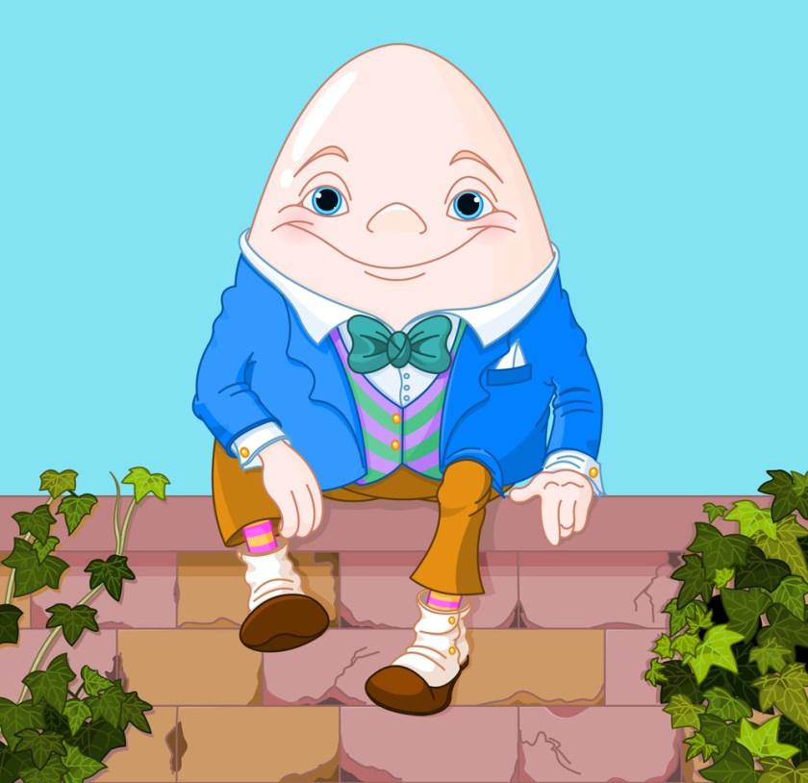
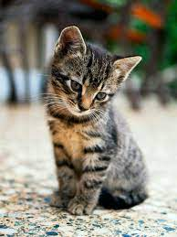
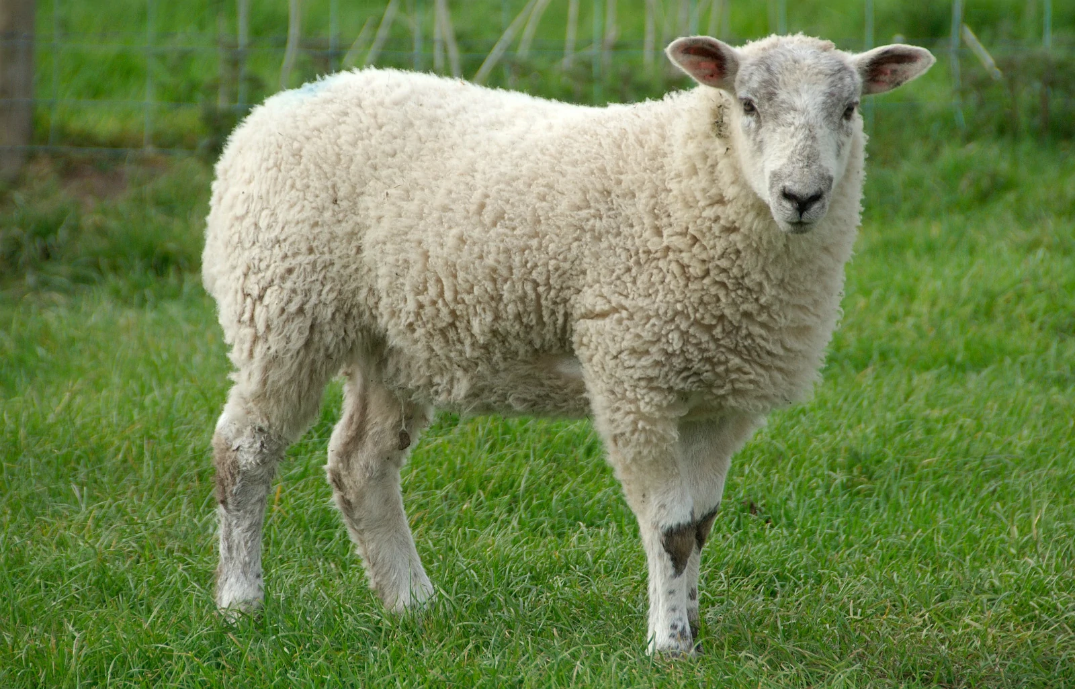
Phase 1
Environmental sounds
Rhyme
Aural blending and segmenting
Rhythm
c-a-t
sh-ee-p

Slide 4
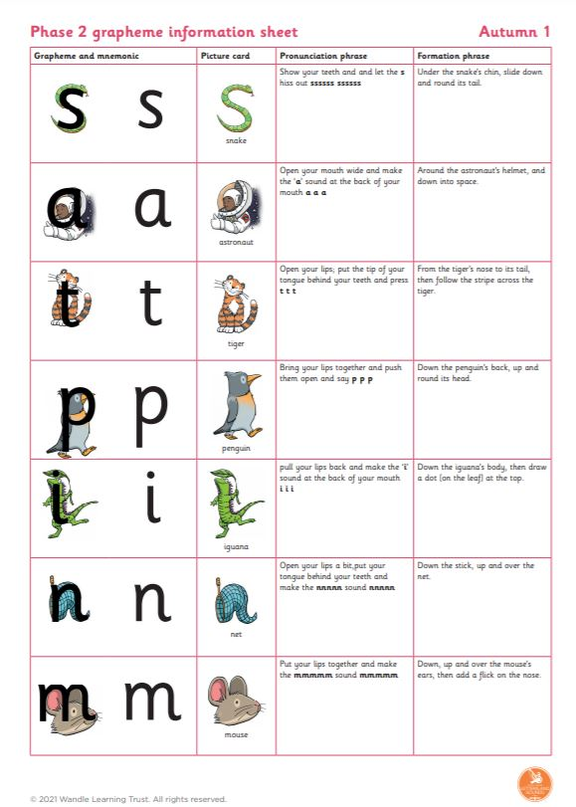
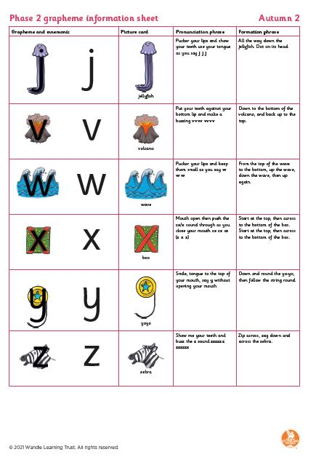

Phase 2…
Made up of 23 phonemes that make a
single sound (ie: s,a,t,p,i,n)
Children will learn to blend and segment
immediately so that they are reading and
will begin knowing how to represent sounds
in their writing
They should be able to read 90% of phonic book independently
s a t
. . .

Slide 5
Pure sounds…
Its really important to say the sounds in a pure way- otherwise when children blend or segment to hear/ read or write words, they will find it tricky
https://www.youtube.com/embed/shlSQrleibs?rel=0

Slide 6
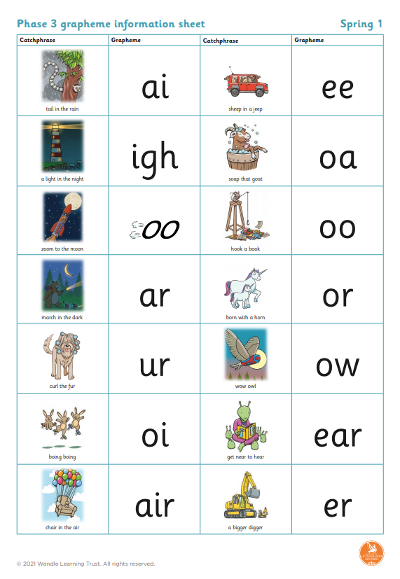
Phase 3…
This is the introduction of more than one letter
making one sound ( digraph/ trigraph)
Children will then have a way to represent every sound
They will come across others in reading (split digraphs etc)
But won’t learn them formally until year 1 (phase 5)
r ai n
. . .

Slide 7
Phase 4…
Teaches children to blend and segment longer words with adjacent consonants
cvcc/ccvc/ccvcc words ( wind/ soft/ list/ stop/swamp)
Polysyllabic words ( children/ melting/ shampoo)
Compound words (windmill/ handstand/ sandpit)

Slide 8
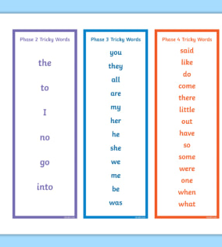
Tricky words…
Words that we can’t sound out –
we just have to learn them!
Play games with them –bingo,
tricky word match, put them around the
House- tricky word hunt!
Tricky word songs ( youtube)

Slide 9

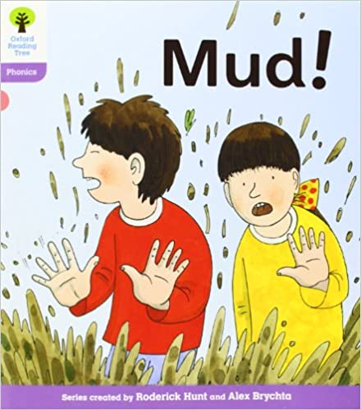
Reading in F2 and at home…
We will match very carefully reading books to children phonic level- need to be able to read 90% of the book independently ( feel like a successful reader! )
Little and often is the best way! Choose a time they aren’t tired or hungry! 5 minutes is often enough…
Sharing books are really important too to develop a love of reading and story language!
We aim for ‘5 texts a day’ in class! Repetition is brilliant for learning!
We don’t want to race through bands- children need to feel secure in
What they are reading and consolidate it.

Slide 10
How can you help at home…
Reading with children at least 3 times a week ( little and often!)
Playing games with the tricky words of the phase they are learning
Going over the sounds they have learnt in the week- go on a sound hunt and find things starting with that sound, play I spy with sounds…
Read stories to them and enjoy them together
Model that you read and write- for purpose and pleasure! Write the shopping list together and take it to the shops, read a menu at a café, read in front of them- they will do what you do!

Slide 11

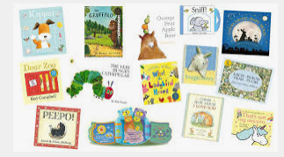
Berry Hill Reading Challenge
Read 3 times a week.
Receive a raffle ticket to put into a draw.
At the end of each half term, 1 or 2 names per class are pulled out of the jar to win a book of choice.

Slide 12
Any questions…

