Slide 1

Teaching and Learning at Berry Hill
Lesson Structures and Expectations

Slide 2
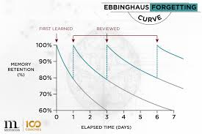
At Berry Hill, our curriculum and lesson design is based on evidence from cognitive science:
Learning is most effective with spaced repetition
Prior learning is explicitly referred to and linked to current learning to support the children to build on their existing schemas
Retrieval of previously learned content is frequent and regular, which increases both storage and retrieval strength, enabling the children to commit core learning to memory.
Learning is delivered in small steps, including an explicit practice before the children are expected to work independently.
All lessons include modelling as a method of cognitive support, in which the teacher clearly demonstrates a task while thinking aloud.
We expect children to engage in independent practice to support them in becoming fluent in their learning.

Slide 3

How do we frame the learning?
The curriculum at Berry Hill is underpinned by five pillars which are woven throughout learning.
At the beginning of each session, these should be explicitly referred to so that the children can see how their learning will link to the DREAM drivers.
E.g.
“Today’s History lesson will explore our resilience strand, because we’re going to be looking at how the Vikings and the Anglo Saxons fought for control over the 8th and 9th Century.

Slide 4
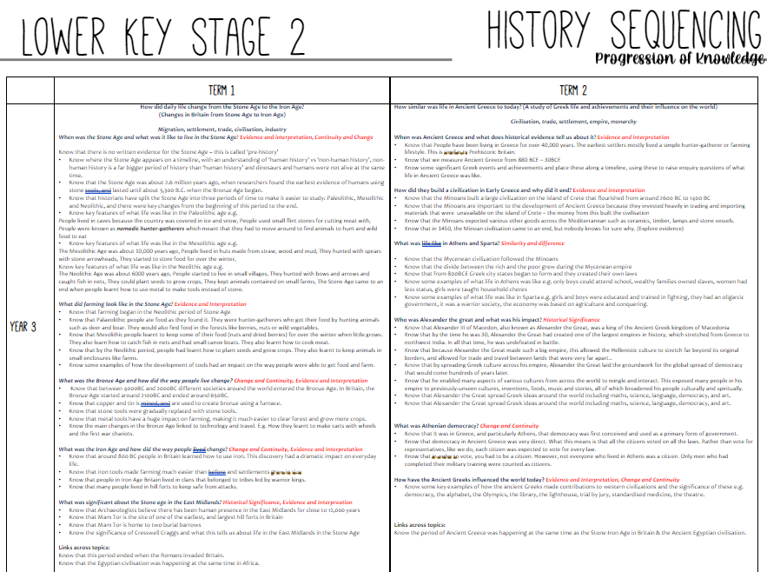
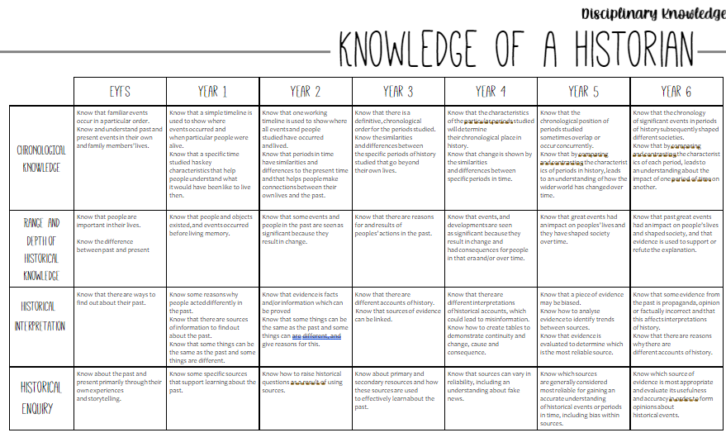
How do we frame the learning?
Our lessons begin with making the core learning explicit through the setting of a learning question. Learning Questions should focus upon a process rather than merely a task. For example:
LQ How do I make a timeline about ancient Greece?
This is task orientated, focusing on how to make a timeline about Greece.
LQ: How can I represent chronology in a chart?
This explores the concept of chronology and reinforces which historical concept the children are focusing on. Although the outcomes from these LQs may appear the same, by framing the LQ in this way, pupils should be more aware about the historical skill they are developing.
The Learning Question should mirror the progression documents set for the year group.
Curriculum
Assessment and Education
Practice

Slide 5



Dual Learning Questions
In History, Geography, RE and Science, we set dual learning questions, which include a substantive and a disciplinary learning question. Again, these mirror the learning set out within progression documents.
We use symbols to support the children in knowing explicitly which aspects of these subjects they are developing.
Please see example below:
Monday 19th February 2024
LQ: When was Ancient Greece and what does historical evidence tell us about it?
DLQ: Can I analyse different accounts of history?
It is really important that the symbol used matches the LQ carefully. If unsure, please speak with Ahmed Abbass who is our History lead.

Slide 6

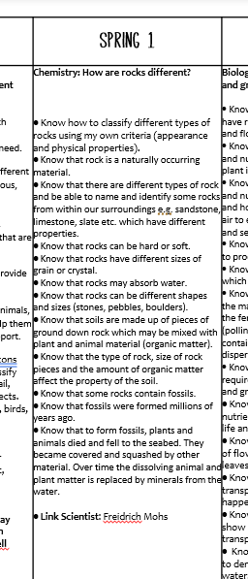


Dual Learning Questions
Monday 19th February 2024
LQ: What are some rocks within our area and what properties do they have?
DLQ: How do I construct a simple classification key using given information?

Slide 7

What does a Berry Hill lesson look like?
Reflect on feedback
Children have a few minutes to complete their response to feedback / pinks. Having a timer on the slide is helpful to support the children to self-regulate and engage well for the duration of the task. The teacher circulates to support.

Slide 8
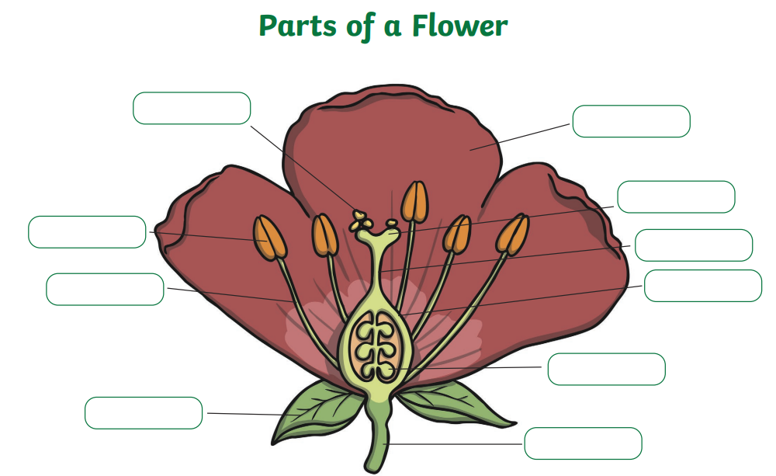
Retrieval Practice
A quick memory check of something learnt previously – sometimes from the previous lesson or beginning of the topic, depending on what the teacher feels needs to be reviewed regularly to support the children in transferring this knowledge into their long-term memory. This is most effective when children complete them independently and individually. Please see the list to the left of this slide for some retrieval practice ideas. Retrieval practice does not always need to be recorded in books. There needs to be a minimum of 2 recorded per half term, however.
Retrieval Practice ideas
Low stakes quiz – small sheet of quiz questions that children complete on their own
Close procedure exercises, such as completing a diagram or completing missing words in a sentence.
Matching vocabulary to definitions
Paired Quizzes using a piece of learning from the last lesson
Quiz, Quiz, Trade
Rally Robin - In pairs, students alternate generating brief oral responses. E.g. list all of the things a plant needs to survive
Brain dump – write down everything you can remember about X in 3 minutes…
A question from Last year, last term, last lesson
Create your own flashcards, then use the flashcards in subsequent lessons
Odd one out – children given multiple choice questions and provide their reasoning.

Slide 9

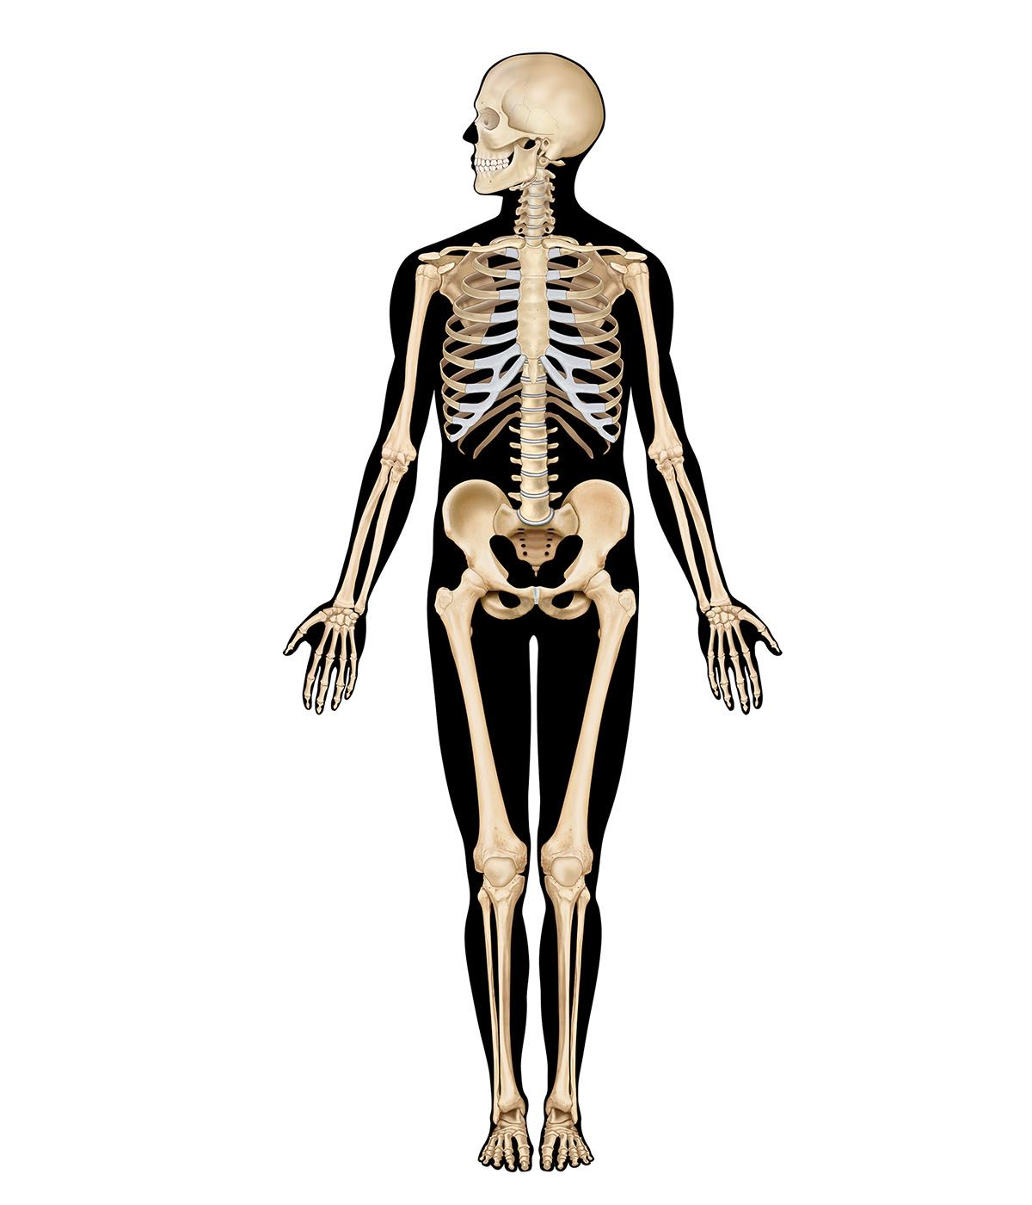
LQ: Know that some animals have skeletons and some do not
LQ: Know that multiple groups can be used when sorting.
Think it / Revisit
What do you know about skeletons?
This slide is to fire up children’s existing schemas! What do they already know about the topic? What have they learnt before? BE SPECIFIC “In year 2 you learnt about some key parts that all humans have, can you remember what they are?” It’s helpful to link with the previous year group to share slides the children have seen before the previous year!

Slide 10
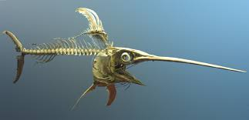
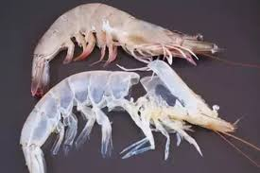
LQ: Know that some animals have skeletons and some do not
LQ: Know that multiple groups can be used when sorting.
KEY VOCABULARY
Endoskeleton – an internal skeleton
Exoskeleton – a hard outer skeleton that protects and supports an animal's body
This slide is to explicitly share new vocabulary to the children and explain what it means within the context of the lesson. It is vocabulary that will go on your display board and is written within your progression of learning. It will be helpful to have images to aid understanding.

Slide 11
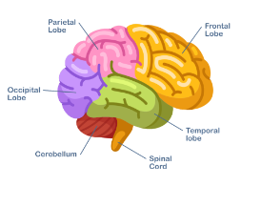
Lesson input…
These slides are where you share small step content that children need to know. Always consider if a powerpoint is needed -can some things be shared under the visualiser or be done in a more practical way?
If slides are used, please only include relevant details on the slide. In order to prevent cognitive overload, and also support our Dyslexia Friendly School status, please avoid overloading slides with information, and keep ‘decoration’ to an absolute minimum.
Also consider the importance of Dual Coding:
Dual coding is combining words and visuals such as pictures, diagrams, graphic organizers, and so on. The idea is to provide two different representations of the information, both visual and verbal, to help students understand the information better.

Slide 12
Model
LQ: Know that some animals have skeletons and some do not
LQ: Know that multiple groups can be used when sorting.
The ‘model’ slide is where the teacher demonstrates to the children HOW to do the task, while using a ‘thinking aloud’ strategy. Make use of the visualiser, flip chart paper, or practical demonstrations. Just make sure everybody can see!

Slide 13
Practice
LQ: Know that some animals have skeletons and some do not
LQ: Know that multiple groups can be used when sorting.
Can you classify two of the animals on your own?
Set a small challenge so that you can check the children’s understanding of how to carry out their learning task…

Slide 14
Independent learning
LQ: Know that some animals have skeletons and some do not
LQ: Know that multiple groups can be used when sorting.
Remind the children of the expectation of the task….set a timer to help the children to self-regulate their time.

Slide 15


How do we challenge thinking?
‘Deepen the moment’ tasks are set to support the children in achieving deeper reasoning for their new learning. They are often framed around the question ‘why’, to encourage children to build greater connections in their learning and explain their understanding in depth.
Challenge Tasks …
Think like a….Scientist!
Now that you understand the heart’s role in the circulatory system, do you think the heart of a whale would be bigger or smaller than the heart of a human?
Explain your answer.
At least 2 ‘Think like a …’ tasks in a typical 6 week block need to be for all children – you would probably begin the lesson with this.

Slide 16

Reading at Berry Hill
Reading lessons at Berry Hill take a very specific structure. From EYFS to KS1, Little Wandle is used as the method of teaching reading, with a fluency programme being implemented across year 2 in readiness for KS2. In KS2, we deliver reading through Reciprocal Reading, alongside our own devised programme to support development of fluency and comprehension.
Please see the guide below for clear direction of how to teach reading at Berry Hill. There is a summary on the next few slides.
Berry Hill Reading Guidance finalised.docx
Monday 19th February 2024
LQ: Scan for key words, phrases and headings to decide which sections of text to read more carefully to fulfil a particular purpose e.g. to summarise a text.

Slide 17
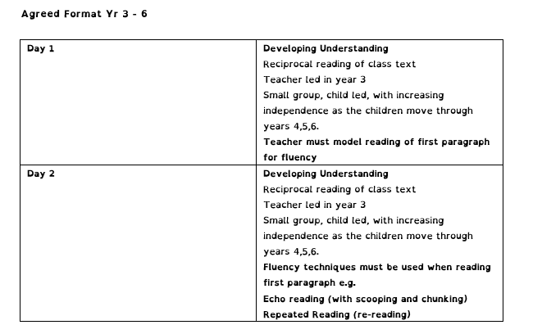
Reading at Berry Hill

Slide 18
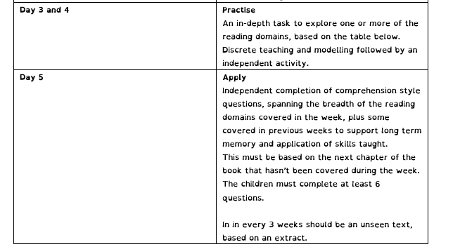
Reading at Berry Hill
Teachers should use the reading progression grids to set LQs for each session, and should use QLA from summative assessments to determine areas of need for their class / cohort.

Slide 19
Maths at Berry Hill
White Rose Maths is used to structure Maths learning at Berry Hill, but the same lesson sequence should be implemented.
Lessons begin with response to feedback and retrieval practice (Flashback 5, times tables) before presenting the new learning for the day, which is unpicked together as a class. The class teacher should explicitly demonstrate new learning, whilst giving opportunities for the children to practice independently before starting their learning task.
Our expectation is that the White Rose Learning Slides are adapted to suit the needs of the children in the class.

Slide 20
Writing at Berry Hill
For writing lessons at Berry Hill, we use a tailored approach to Jane Considine's ‘The Write Stuff’ – Please click on the hyperlink below to see how this should be set out across a sequence of learning, but also within the children’s books.
July 2024 Writing meeting

Slide 21
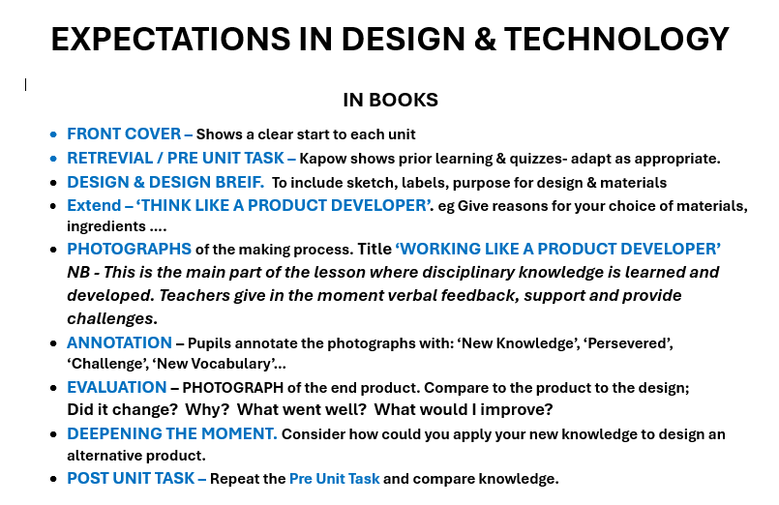
DT

Slide 22

Task Design
Good task design will often take into account teachings from Cognitive Load Theory, Generative Learning, and Extended Mind Theory

Slide 23
Task Design
Good task design will often take into account teachings from Cognitive Load Theory, Generative Learning, and Extended Mind Theory
A task is not an activity. A task should be there to either support the children in building fluency of knowledge or to test their understanding.
Think about what you are assessing before designing a task.

Slide 24
Cognitive Load Theory
Cognitive Load Theory emphasises the importance of designing tasks that optimise the mental effort required by students. By minimising unnecessary cognitive load, students can focus more effectively on learning the key concepts. This can be achieved through techniques such as breaking down information into smaller, manageable chunks and using carefully curated visuals or icons to support understanding

Slide 25
Generative Learning
Generative Learning is based on the idea that learners actively generate their own understanding by linking new information to existing knowledge.
This approach can be facilitated by tasks that require students to sort, organise and explain in their own terms once they have had an opportunity to integrate this within their own understanding using the SOI model. These types of activities help deepen their comprehension and retention of the learning.

Slide 26
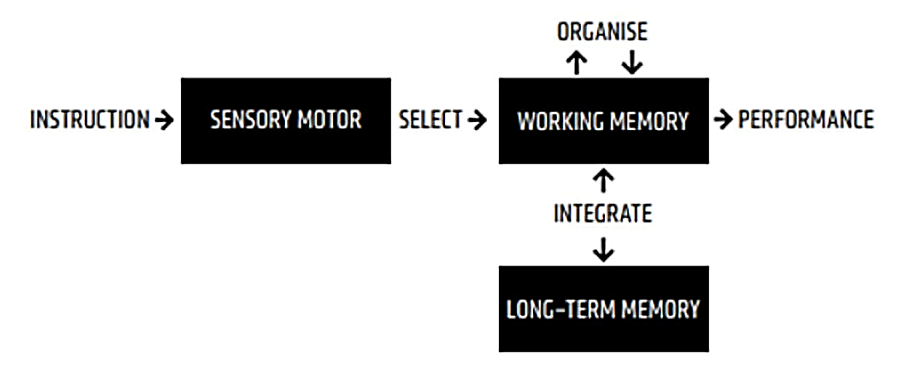
Generative Learning
Select Organise Integrate

Slide 27
Extended Mind Theory
Extended Mind Theory states that cognitive processes can extend beyond the mind to include ‘external’ tools, environments, and interactions with others. In the classroom, this can be applied by using oracy approaches such as rehearsal and structured discussions where students can use each other’s knowledge. Creating or using graphical representations would also fit this approach.

Slide 28
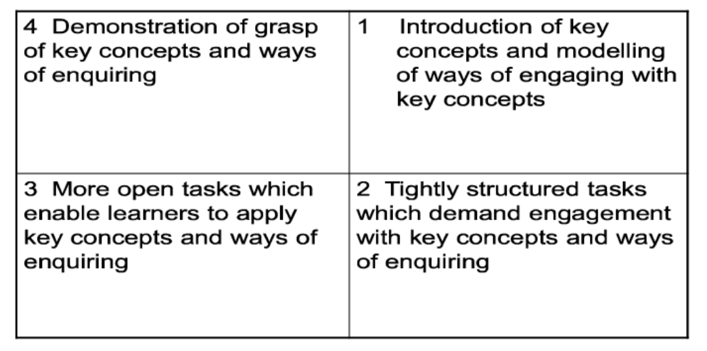
Edward's Task
Design Model
Edward's (2015) task design model can be helpful in deciding how to structure a task that engages, encourages creativity, but also sticks closely to what is being learnt.

Slide 29
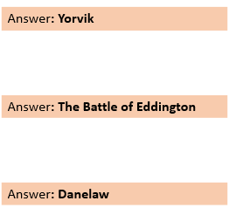
What’s the Question?
What’s The Question?
Probably Fact Probably Fiction
What’s The Question enables pupils to reflect on when they have encountered certain vocabulary. Some terms may have more than one correct question which can stimulate debate.

Slide 30

Probably Fact Probably Fiction
Probably Fact
Probably Fiction
Probably Fact Probably Fiction
Zones of Relevance / Significance
History and Mythology can be blurred. Asking pupils to sort details of a narrative into probably fact and probably thinking promotes critical thinking. This would be particularly applicable for thinking about the story of how Rome was formed (Romulus & Remus).

Slide 31
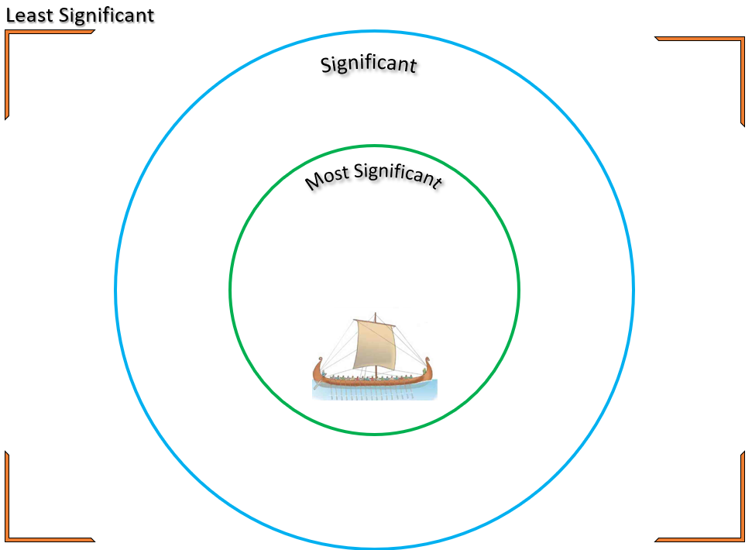
Zones of Relevance / Significance
Zone of Relevance / Significance
Venn Diagram
In this example, pupils are given 10 or 7 reasons for why the Vikings invaded Britain. Their first task is to collectively decide in small groups which reason they think is least important which will leave 9 or 6. The task is then to work out where the different reasons would sit on the diagram. They could then write a justification of their top choice.

Slide 32
Venn Diagram
The Venn Diagram
In a Nutshell
The Venn diagram allows pupils to compare two or more concepts. It focuses on identifying the similarities and differences in those concepts. It can be used as a step towards writing an analytical or evaluative text.

Slide 33

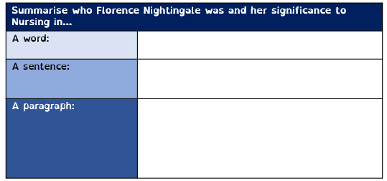
In a Nutshell
In a Nutshell
Cloze Procedures
In a Nutshell encourages pupils to start with the most vital elements of something and then gradually expand upon what they know. As a twist, pupils could be asked to do this in reverse, filtering their responses into increasingly succinct and key responses.

Slide 34
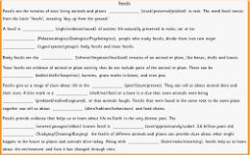
Cloze Procedures
Cloze Procedure
Identification Table
The cloze procedure is a useful task for introducing numerous facts about a concept. This can give teachers the chance to focus on specific vocabulary within a larger concept; a process being studied or a particular action.

Slide 35
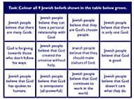
Identification Table
Colour all 9 Jewish beliefs in the table below in green
Identification Table
Hexagonal Thinking
The identification table provides a means of identifying true and false facts. This is particularly useful to identify or highlight misconceptions or opposing facts. It can be used as a step to writing a simple information text.

Slide 36
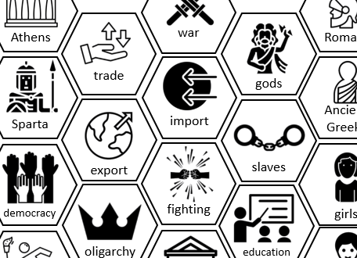
Hexagonal Thinking
Hexagonal Thinking
Factor Pairs
The six-sided hexagons enable pupils to explore key concepts and make connections. They can either be presented with the concepts already identified and the touch points already in place to explore the link, the concepts identified but the children decide what links to what, or a blank hexagons which the children fill.

Slide 37
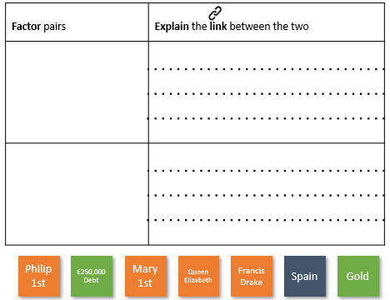
Factor Pairs
Hexagonal Thinking
Think & Link
Similar to Hexagonal Thinking, Factor Pairs gives pupils a range of substantive aspects and invites them to pair these with a view to explaining the links.

Slide 38
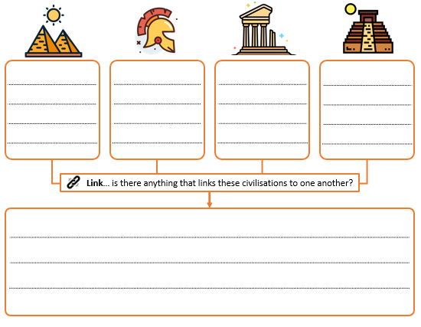
Think & Link
Think & Link
Kernel Sentences
This activity is initially a retrieval task where children recall what they know about elements of a topic or subject before then considering the links between in a final paragraph.

Slide 39
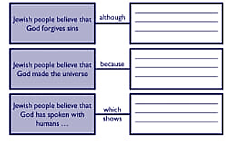
Kernel Sentences
Jewish people believe that God forgives sins
although
Jewish people believe that God made the universe
because
Kernel Sentences
Jewish people believe that God has spoken to humans
which
Bridge Map
shows
Kernel sentences act as a springboard for the connections that can be made within a concept or between multiple concepts. They allow teachers to focus on specific areas of learning so that they can be drawn to a pupil’s attention. Thought can then be stretched or deepened.

Slide 40
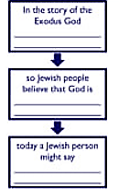
Bridge Map
In the story of the Exodus, God
so Jewish people believe that God is
Bridge Map
Today a Jewish person might say
Fishbone Diagram
The Bridge Map allows children to see close associations or develop specific lines of thinking. Teachers can adapt the bridges so that pupils are led to consider the consequences or connections within a concept.

Slide 41
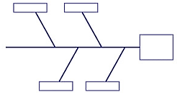
Fishbone Diagram
Fishbone Diagram
Conversation Starter
The Fishbone Diagram is an analytical tool for investigating complex problems which have multiple components. It can be used both as a tool to breakdown a specific concept or as a means to build up a pupil’s non-hierarchical understanding of a concept.

Slide 42
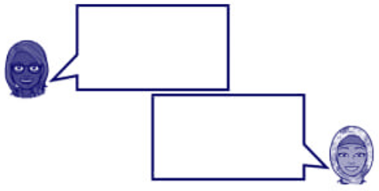
Conversation Starter
Conversation Starter
Diamond Nine
The Conversation Starter allows teachers to engage their pupils in dialogue in a number of ways. Children could be given one perspective and asked to complete the opposing voice or could consider an event from multiple perspectives and complete all voices themselves.

Slide 43
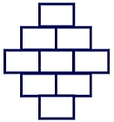
Diamond Nine
Diamond Nine
Three Heads
The Diamond Nine is a task for ranking or prioritising ideas, viewpoints or information. By sorting these, pupils can reflect on the substantive knowledge they have gained. Additionally, the task can allow people to consider their own views and the views of others.

Slide 44
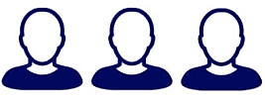
Three Heads
Three Heads
Focus Map
The Three Heads task can be used as a form of concept cartoon. By giving one statement to each head, pupils can be drawn into explaining which statements they agree or disagree with and why. Additionally, it gives children the opportunity to explain who might have these opinions or to identify any misconceptions.

Slide 45
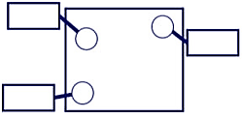
Focus Map
Focus Map
Decision Dilemma
The Focus Map enables teachers to draw their attention to specific elements within either a text or an image (a design feature of a product, an aspect of a historical artefact etc.). In doing so, relationships between evidence and inferences can be highlighted. Comparisons and connections can be highlighted for analysis or evaluation.

Slide 46
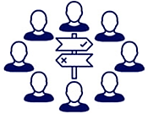
Decision Dilemma
Decision Dilemma
The Decision Dilemma, similar to a ‘corridor of consciousness’, is a task for prompting discussion and evaluation once pupils have gained substantive knowledge. By introducing a dilemma, children apply the knowledge they have gained within a situation and explore how this may impact a person’s life. E.g. impact of the Roman Invasion on a farmer.

Slide 47
Task Design
Take-aways
Good task design should involve children thinking deeply about lesson content – with less energy spent merely paraphrasing content
Sessions and task design should give children varied learning experiences
Alongside high-quality oracy, written elements should evidence understanding over coverage

